Slide 1
Autonomous Cars
Computer Vision and Deep Learning

Slide 2
Environment Setup
Install Anaconda for Python 3
https://www.anaconda.com/download/
Install OpenCV and Tensorflow
conda install opencv3
pip install --ignore-installed --upgrade tensorflow
Try out the sources
jupyter notebook

Slide 3
HISTORY OF THE AUTONOMOUS CAR
The idea of self-driving vehicles dates back much further than Google’s research in the present day. In fact, the concept of an autonomous car dates back to Futurama, an exhibit at the 1939 New York World’s Fair. General Motors created the exhibit to display its vision of what the world would look like in 20 years, and this vision included an automated highway system that would guide self-driving cars. While a world filled with robotic vehicles isn’t yet a reality, cars today do contain many autonomous features, such as assisted parking and braking systems. Meanwhile, work on full-fledged autonomous vehicles continues, with the goal of making driving a car safer and simpler in the coming decades.
https://www.titlemax.com/resources/history-of-the-autonomous-car/

Slide 4
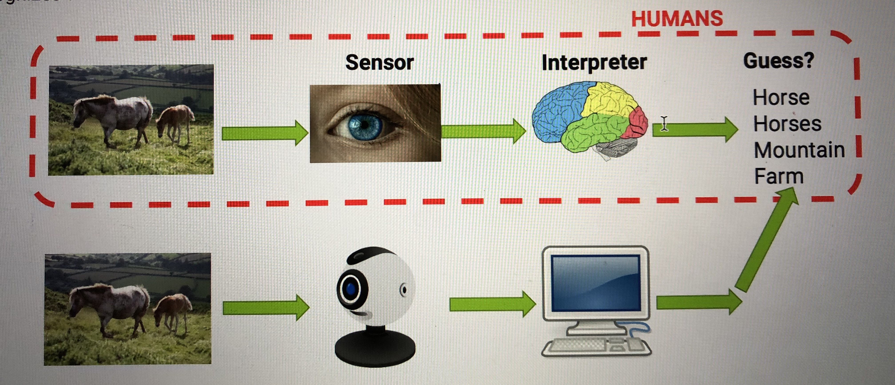
WHAT IS COMPUTER VISION?

Slide 5
WHAT IS COMPUTER VISION?
Science that allows computers to understand images and video and determine what the computer "sees" or "recognizes”.
Use cases:
• Self Driving Cars – pedestrian/car detection • Face recognition • Object detection • Handwriting Recognition • License plate numbers detection • Snapchat filters
Challenges:
• Viewpoints • Camera limitation • Lighting • Scaling • Object variation

Slide 6
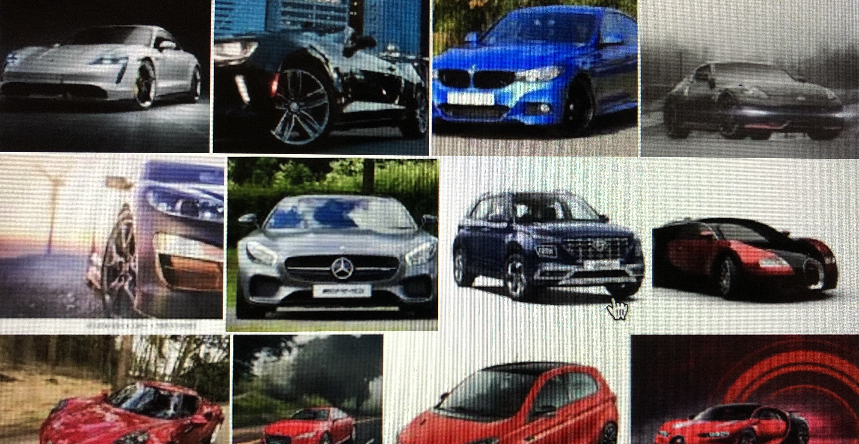

Slide 7
HUMANS VS. COMPUTER VISION SYSTEMS
WHICH ONE IS MORE ADVANCED?
Must provide 360° coverage around the vehicle.
3D vision for 130° of the Field of view ‘blind-spot’
Must identify objects in 3D close and far from the vehicle.
Only central 50° FOV is ‘high-resolution’,
outside central zone,
perception drops
Must meet all requirements in various lighting/weather conditions.
Good performance in varying lighting conditions Process data in real-time.
Equivalent video ‘frame rate’ good in central zone, poor at peripheral vision
assumptions above ignore age, disease and distractions
Conclusion: human eyes provide acceptable vision in a very narrow field of view facing forward.

Slide 8
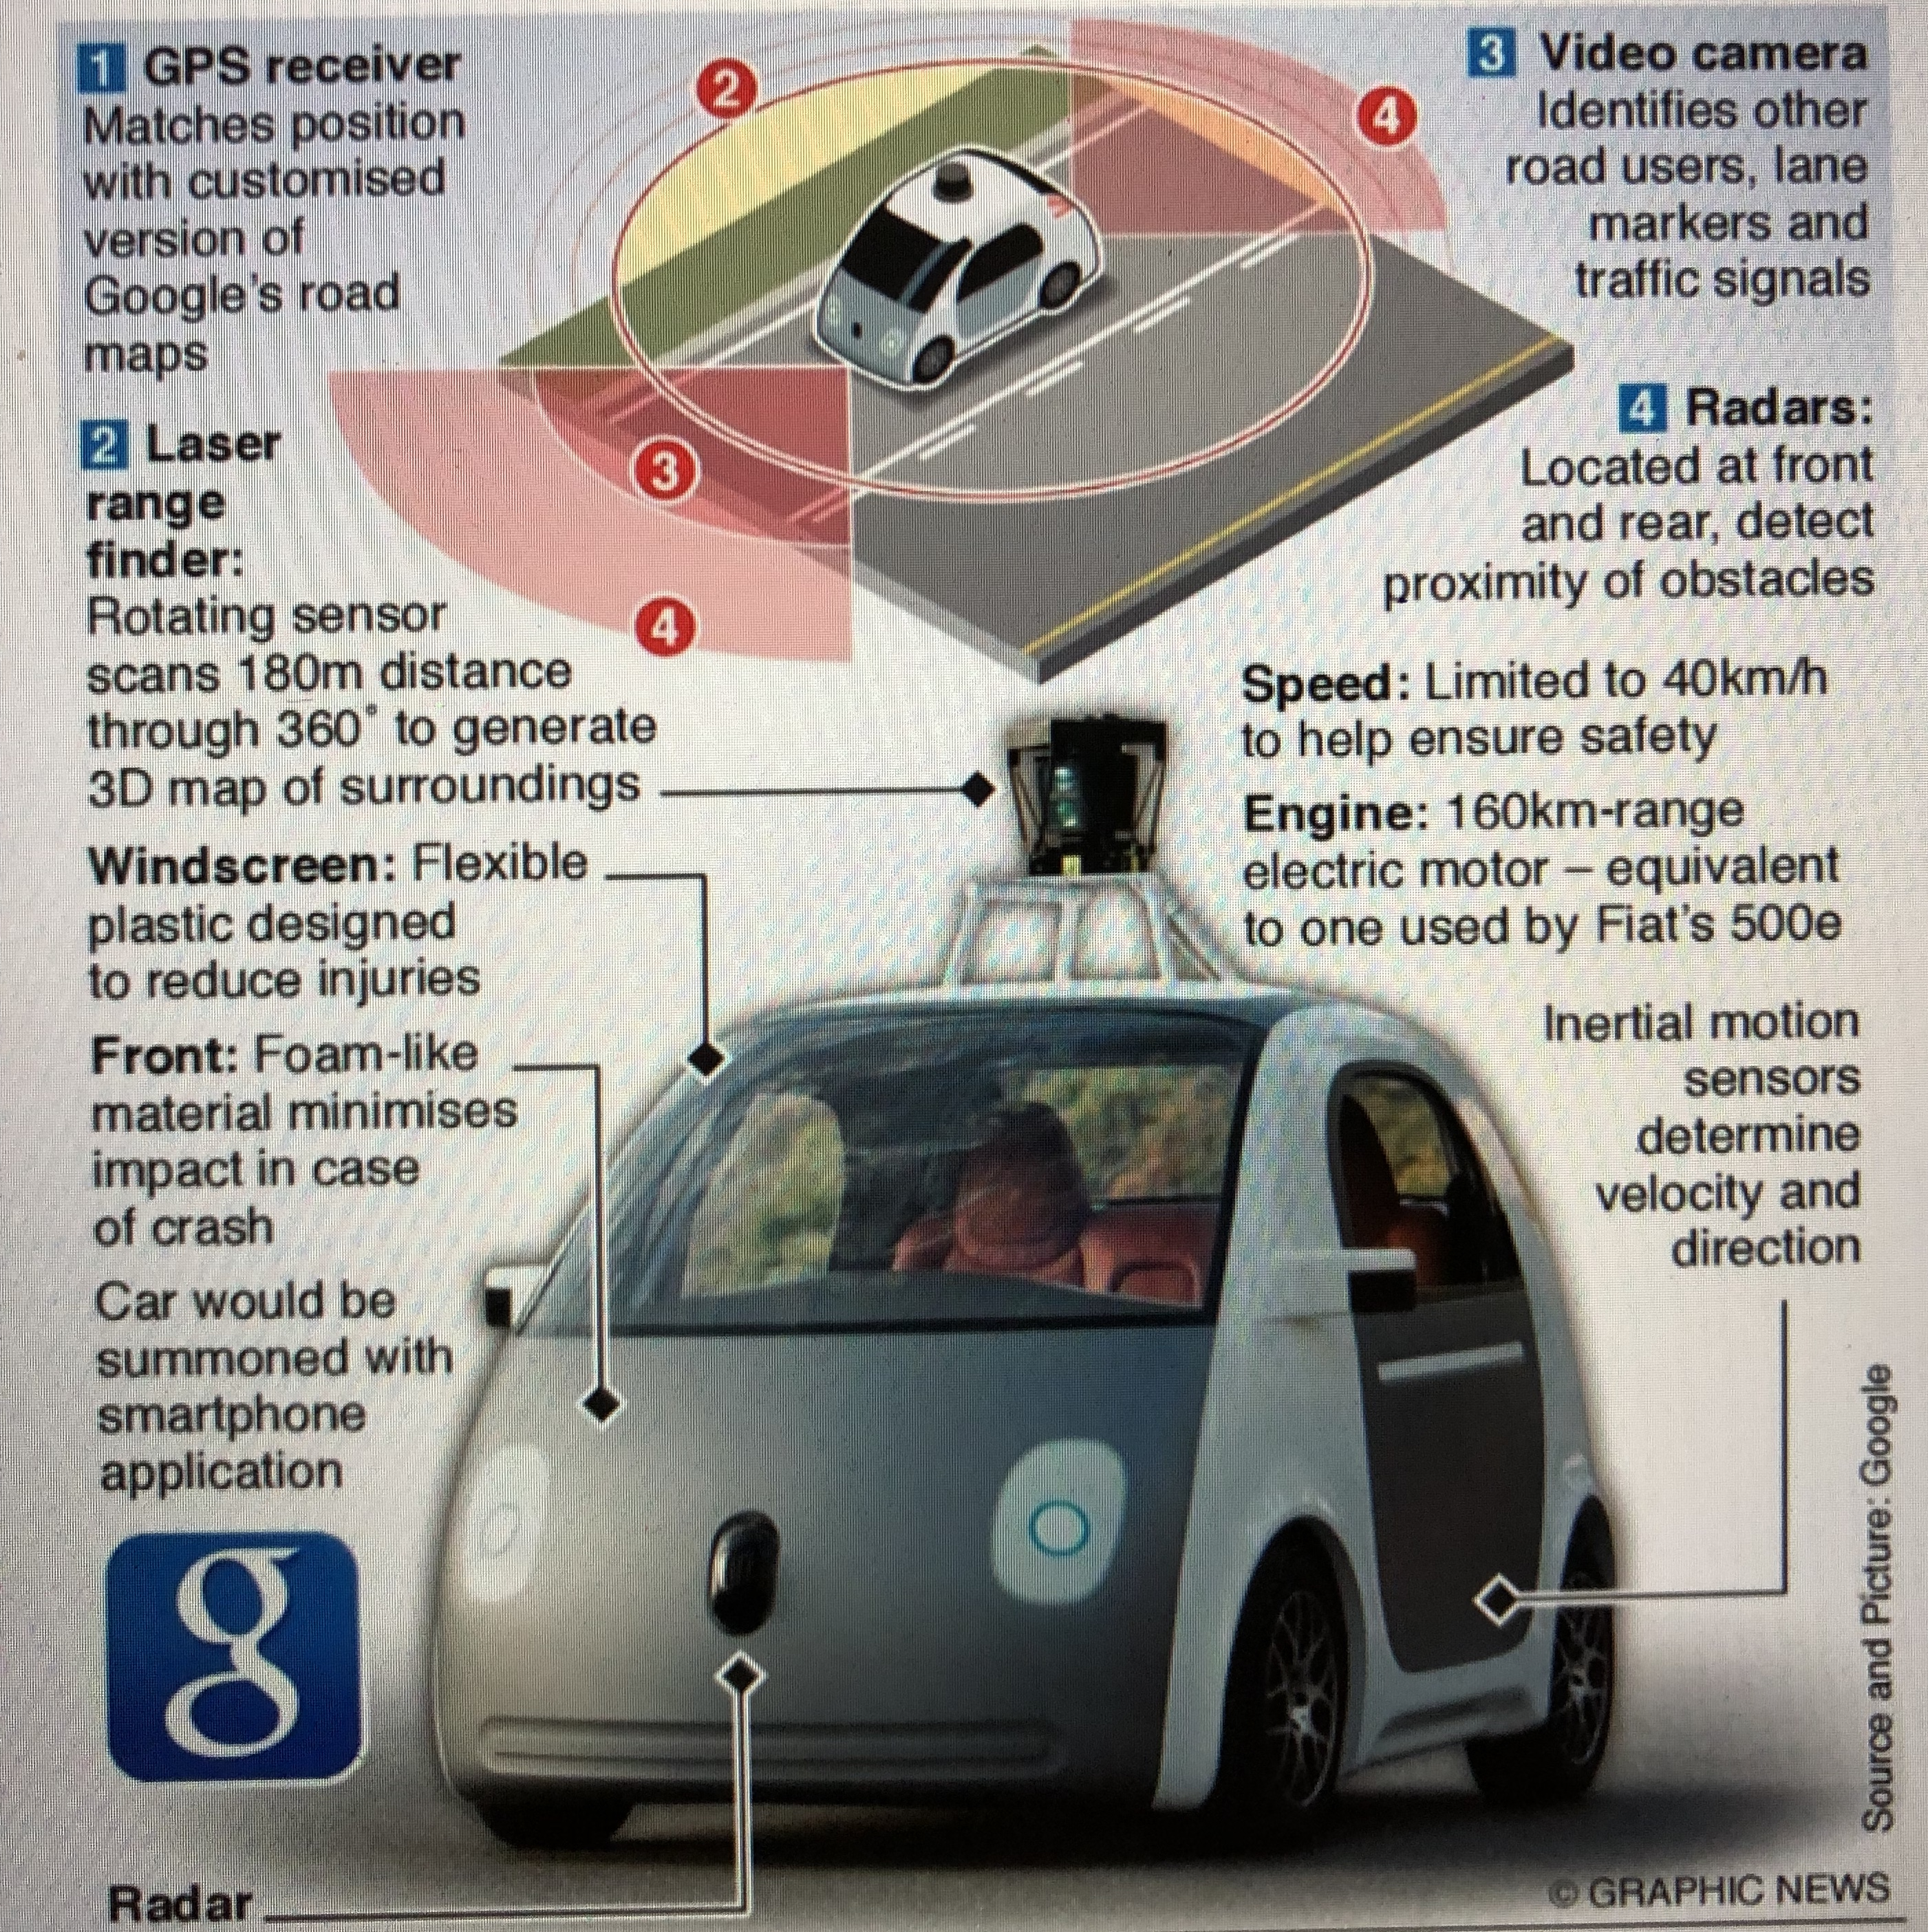

Slide 9
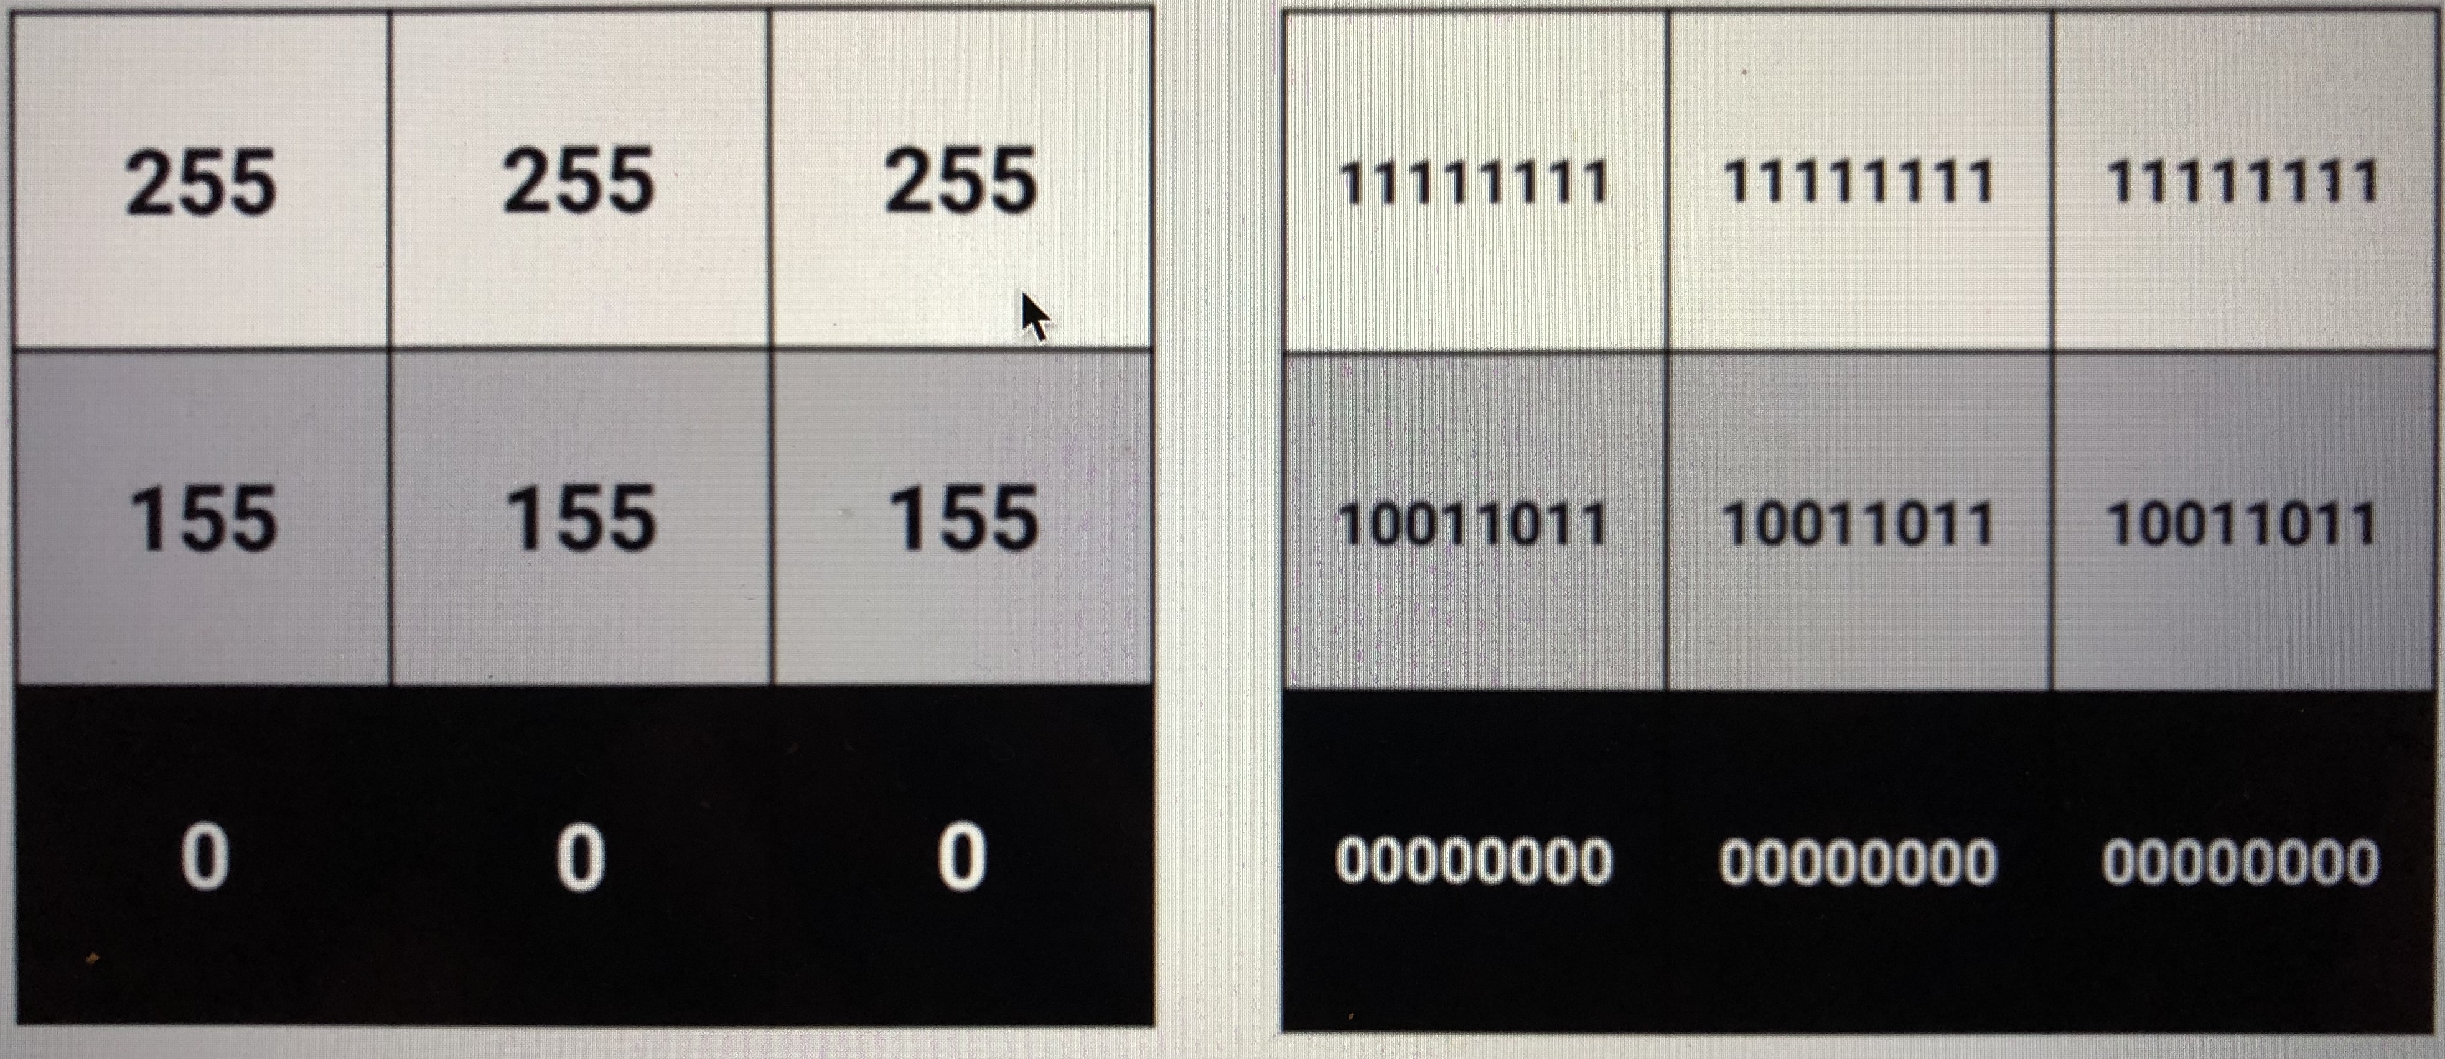
HOW DIGITALLY REPRESENT A GRAYSCALE IMAGE?

Slide 10
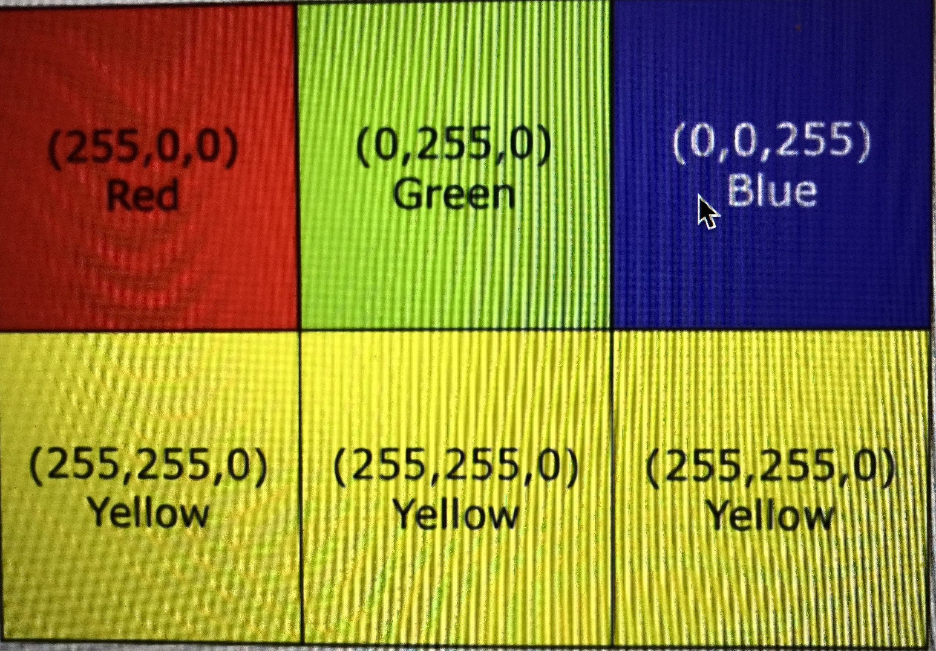
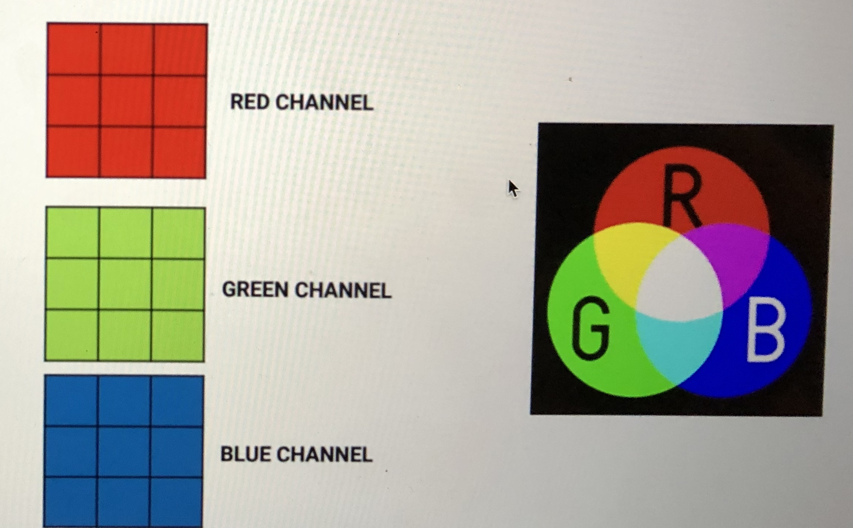
HOW DIGITALLY REPRESENT A COLORED IMAGE?

Slide 11
Activity1:
View Colored Image and convert to gray
Detect lane lines in grey scale image
Detect lane lines in colored image
https://github.com/zyousefi105/portfolio/tree/master/autonomouscars/computer_vision1

Slide 12
COLOR SELECTION
Challenges?
What if the lane colour is not white?
What if it is dark outside under different weather or lighting conditions?
SOLUTIONS?
More advance features like edge corner has to be extracted from the camera image using more sophisticated computer vision techniques.
Vehicles use LiDAR systems to create high resolution 3D digital maps of the surroundings.
Example: in ideal weather conditions, the car collects 2.8 million laser points per second to create the LiDAR map
This is equivalent to collecting up to 600 gigabytes of data per hour.
The car can utilize the map created of the commute during summertime to

Slide 13
COLOR SPACES:
RGB
• RGB color space is made of red, green, and blue and mixing them up can produce any color defined by those primary colors.
HSV
HSV (Hue, Saturation & Value/Brightness) is a color space that stores color information in a cylindrical representation.
HSV color space aligns with the way human vision perceives color-making attributes. o Hue – Color Value (0 – 179) o Saturation – Vibrancy of color (0-255) o Value – Brightness or intensity (0-255)
Learn how to convert from RGB to HSV:
http://www.javascripter.net/faq/rgb2hsv.htm

Slide 14
CONVOLUTIONS:
INTUITION
Convolutions use a kernel matrix to scan a given image and apply a filter to obtain a certain effect.
An image Kernel is a matrix used to apply effects such as blurring and sharpening.
Kernels are used in machine learning for feature extraction to select most important pixels of an image.
Convolution preserves the spatial relationship between pixels.

Slide 15
SHARPENING AND BLURRING
The sharpen kernel emphasizes differences in adjacent pixel values which makes the image look more vivid.
The technique is used to bring out detail in an image by enhancing the contrast of pixels on edges.
The blurring kernel is used to blur a given image by averaging each pixel value and its neighbors.
Blurring Kernel is an NxN matrix filled with ones. Normalization has to be performed.
The values in the matrix has to sum to 1, if sum doesn't add to 1 then image will be brighter or darker
https://en.wikipedia.org/wiki/Kernel_(image_processing)

Slide 16
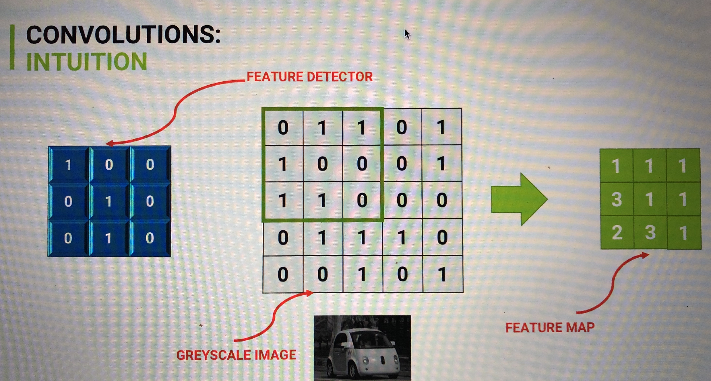
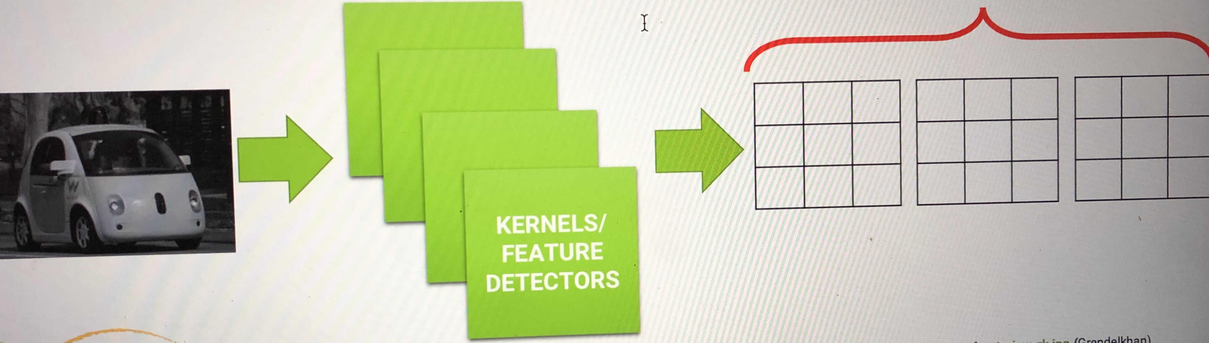

Slide 17
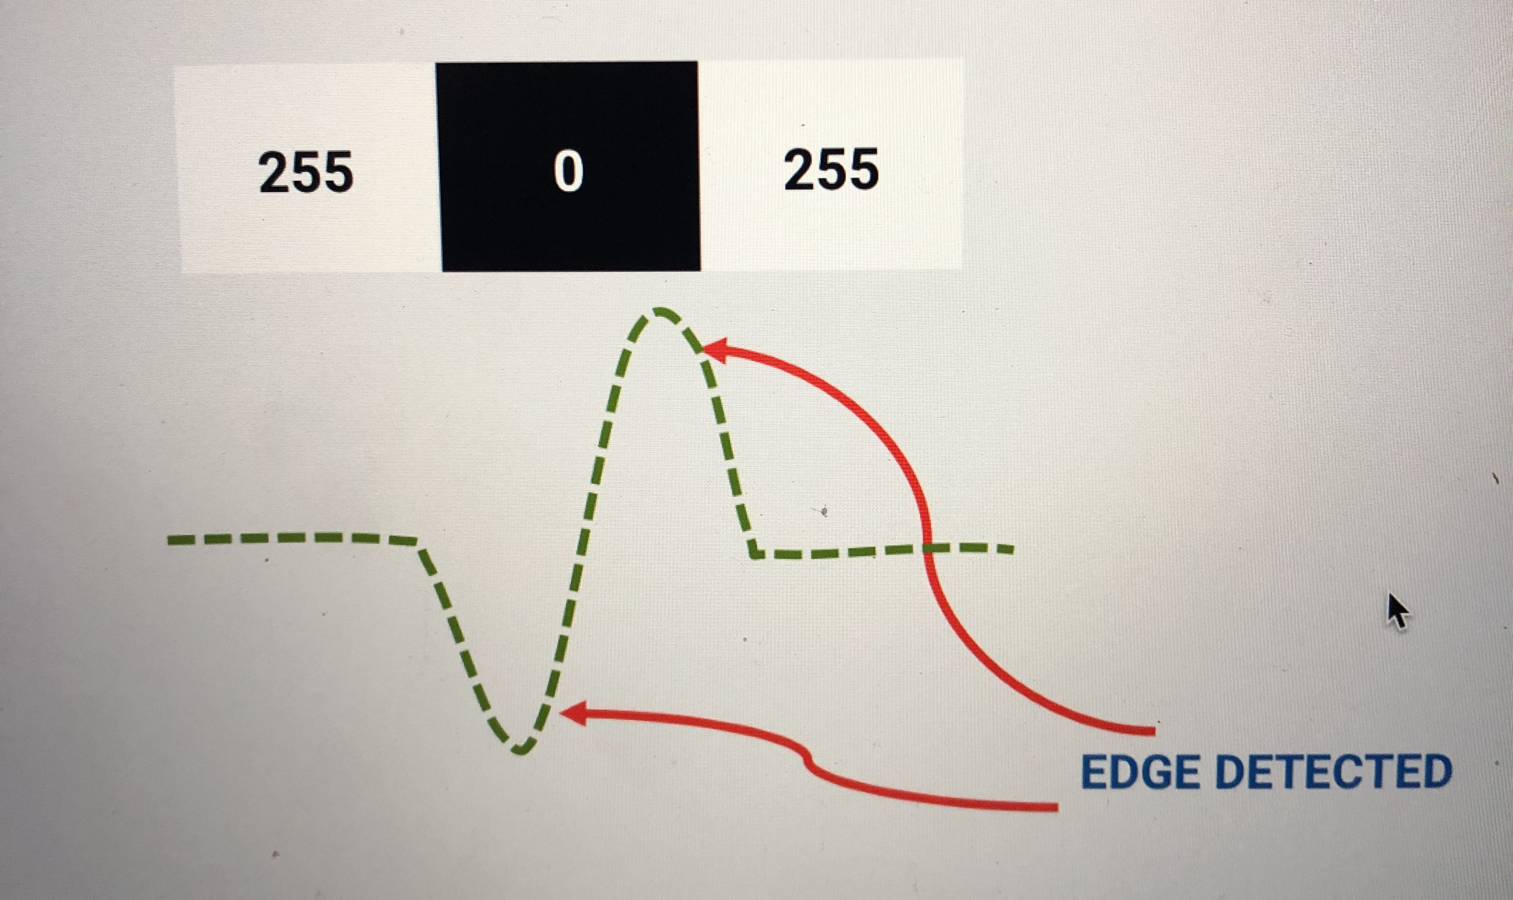
EDGE DETECTION AND GRADIENT CALCULATION
Edge detection is a tool that identifies points in a digital image at which the image brightness changes sharply or has discontinuities.
Edge detection is important tool in computer vision especially for feature extraction/detection.

Slide 18
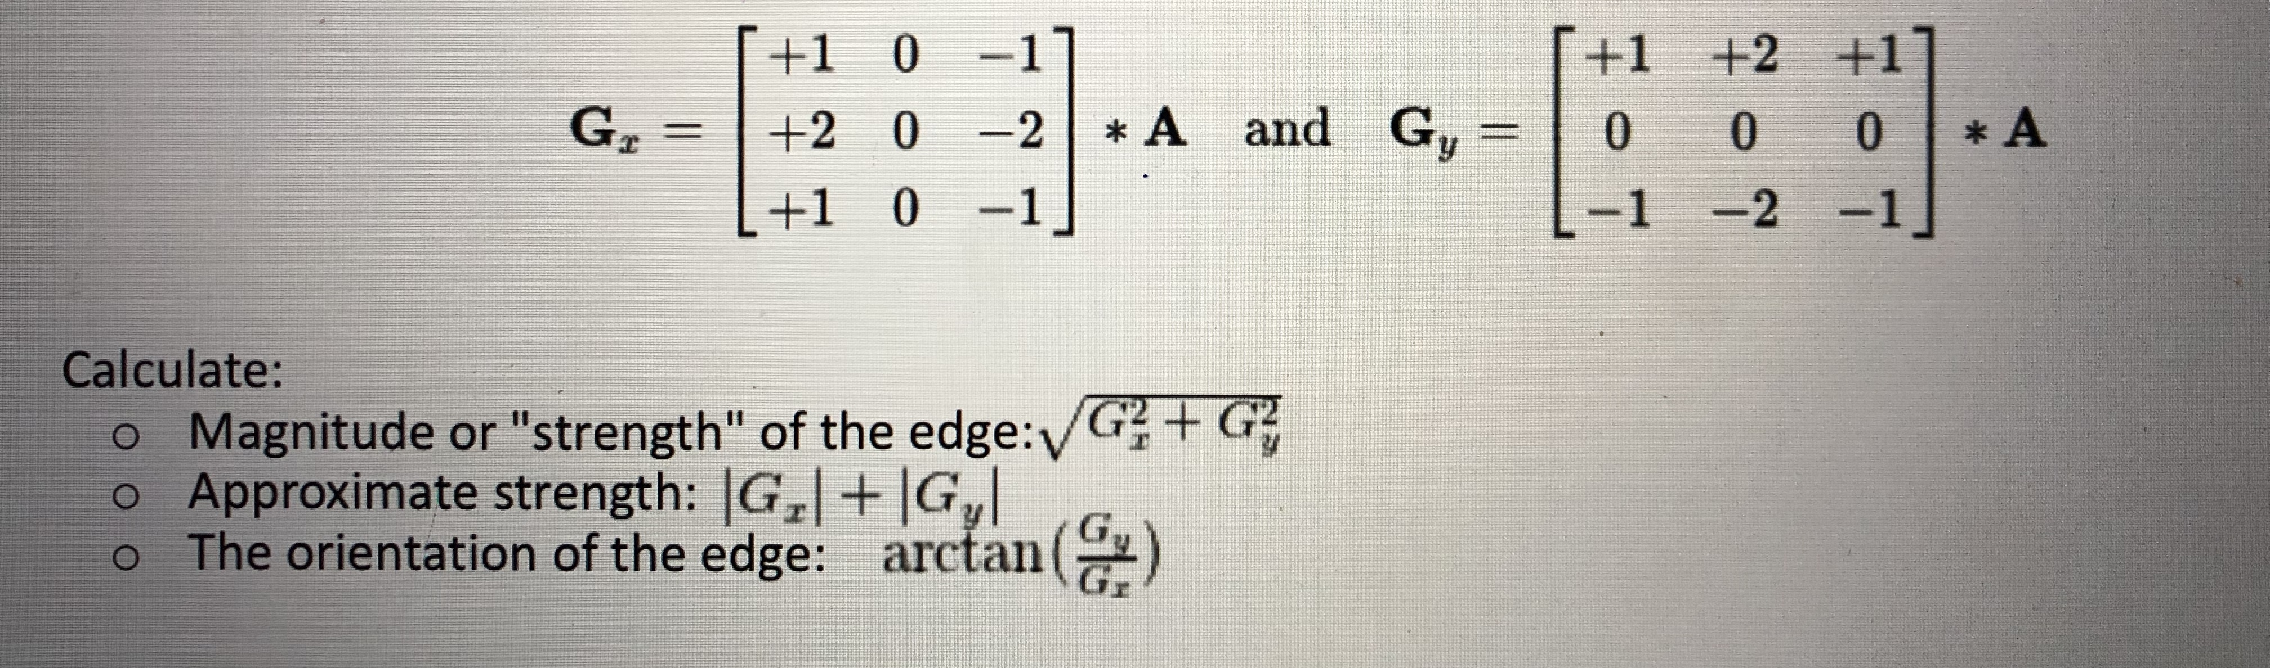
SOBEL
Sobel edge detector is a gradient based method based on the first order derivatives.
It calculates the first derivatives of the image separately for X and Y axes.
Sobel uses two 3X3 kernels which are convolved with original image to calculate the derivatives.
For image A , Gx and Gy are two images representing horizontal and vertical derivative approximations:

Slide 19
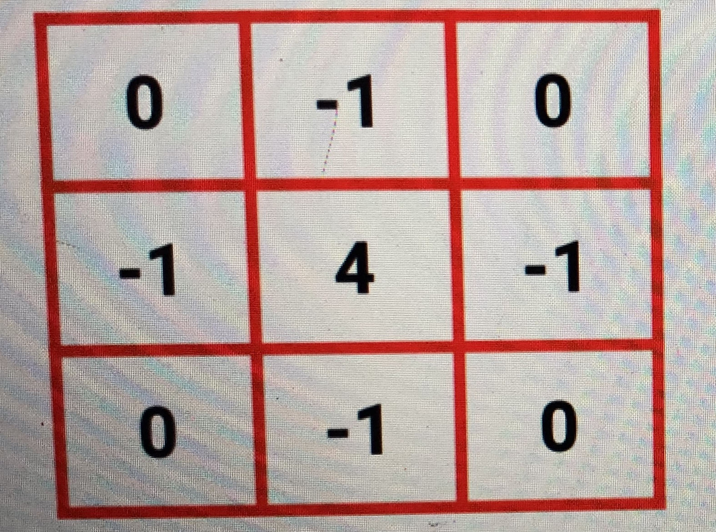
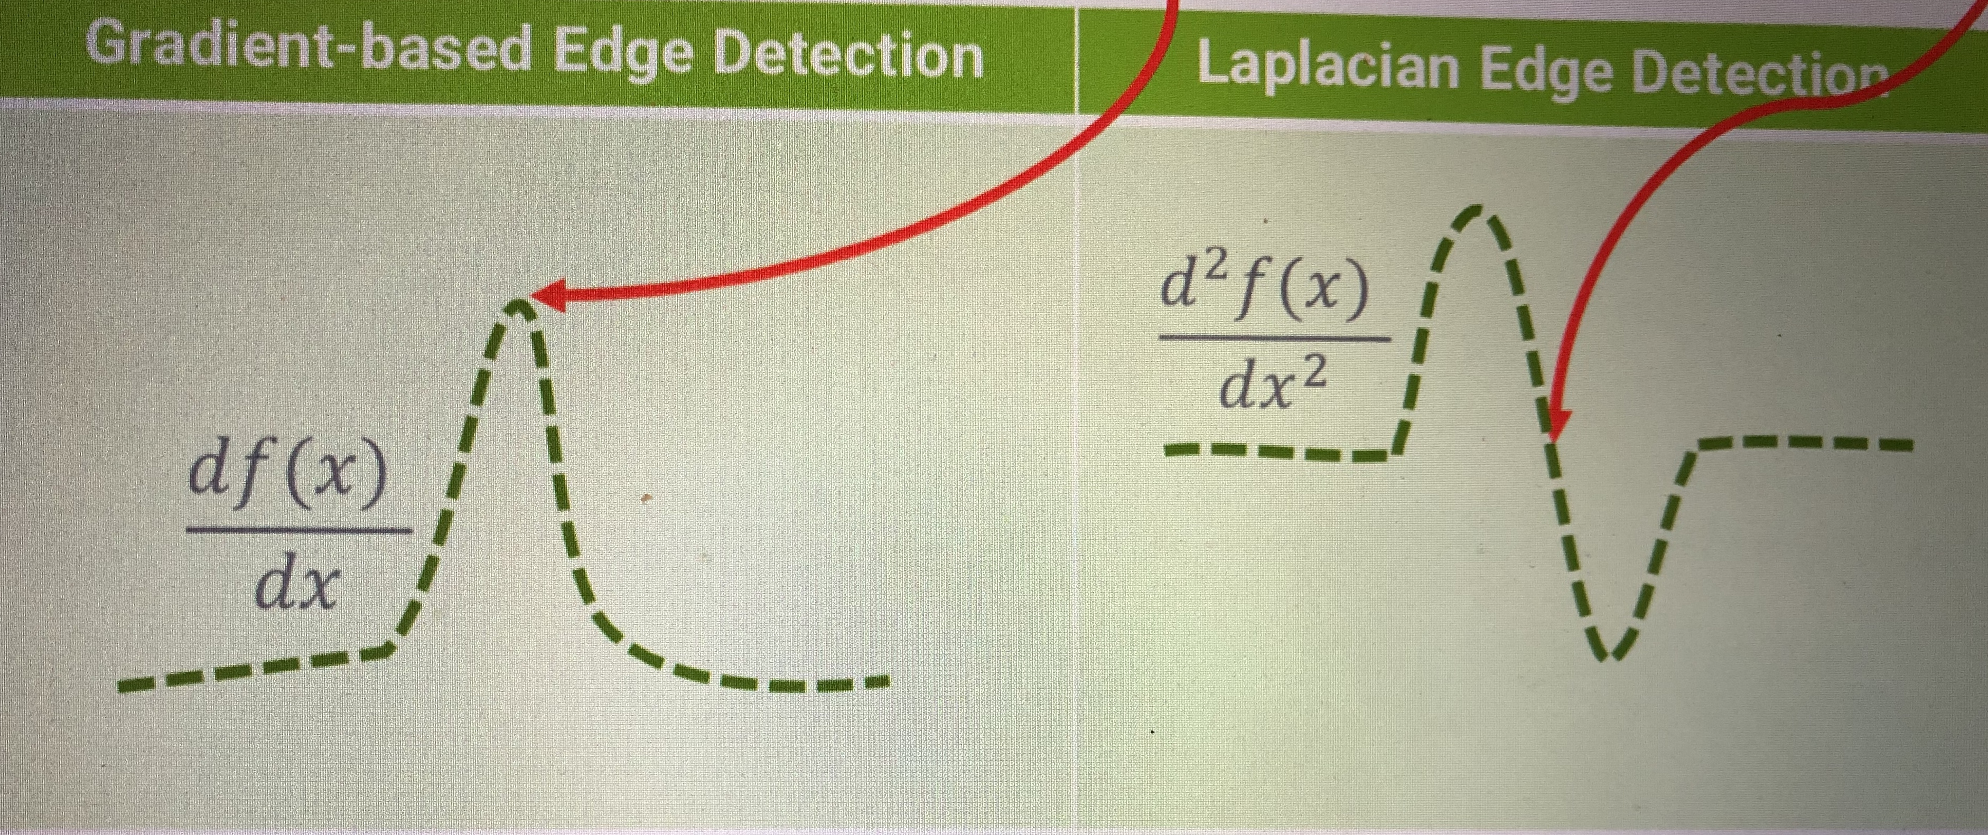
LAPLACIAN
Unlike the Sobel edge detector, the Laplacian edge detector uses only one kernel.
It calculates second order derivatives in a single pass and detects zero crossing.
Second order derivatives are generally extremely sensitive to noise.
The Laplacian kernel is:

Slide 20
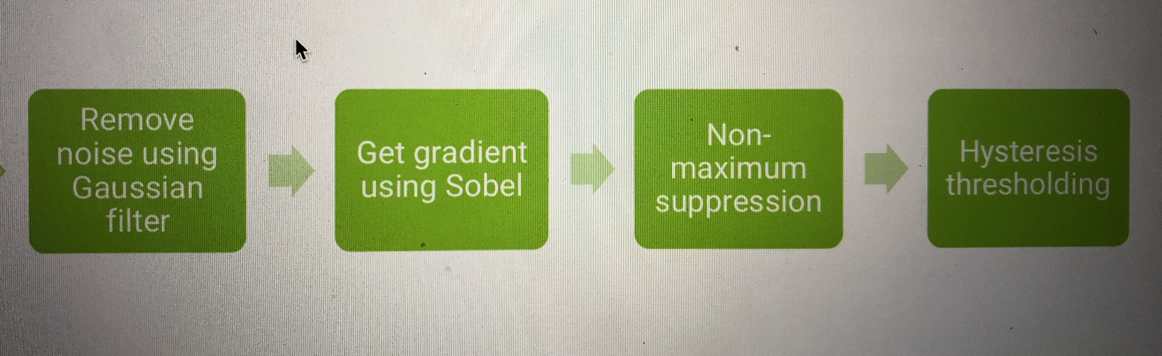
CANNY
1. Smoothing: Smooth the image with a Gaussian filter with spread σ
2. Gradient: Compute gradient magnitude and direction at each pixel of the smoothed image
3. Non-maximum suppression (thinning): Zero out all pixels that are not the maximum along the direction of the gradient (look at 1 pixel on each side)
4. Thresholding: Threshold the gradient magnitude image such that strong edges are kept and noise is suppressed

Slide 21
Activity2:
Color Spaces HSV RGB BGR GRAY and Merge&Split.ipynb
Convolution Sharpening and Blurring.ipynb
Edge Detection - Sobel Laplace and Canny.ipynb
Canny Sobel and Laplace Edge Detection using Webcam.ipynb
http://localhost:8889/tree/autonomouscars/computer_vision1

Slide 22
IMAGE TRANSFORMATIONS
Image transformations are used to correct distortions and/or change perspectives.
ROTATION
TRANSLATION
RESIZING
PERSPECTIVE TRANSFORM
CROPPING
DILATION AND EROSION
REGION OF INTEREST MASKING
HOUGH TRANSFORM

Slide 23
IMAGE FEATURES
Image Features are important areas an image that are unique to a specific image.
A feature is a piece of information in the image such as points, edges or objects that is different/unique.
A feature may be a color or a detected edge.
A good feature has to be repeatable, i.e.: if feature can be detected in two or more different images of the same scene.

Slide 24
WHY ARE FEATURES IMPORTANT?
Image Features are critical in machine learning and self-driving cars because they can be used to analyze, describe and match images.
Features can be used to train a classifier to detect objects such as pedestrians and cars
TEMPLATE MATCHING:
goal is to find objects (truck) in this image using template matching.
cv2.matchTemplate() simply slides the template image over the input image (as in 2D convolution) and compares the template and patch of input image under the template image. The function returns a grayscale image, where each pixel denotes how much does the neighbourhood of that pixel match with template.
Template has to be in the same orientation as in the original image (No rotation is allowed).
Image sizing and scale is a challenge.
Driving conditions such as weather, brightness and contrast.
Perspective will challenge the technique.

Slide 25
CORNERS AND EDGES AS FEATURES
Edges are identified when change in intensity is noticed in one direction.
Corners are identified when shifting a window in any direction over that point gives a large change in intensity in all directions.
Corners are regions in the image with large variation in intensity in all the directions.
Harris corner detection finds the difference in intensity for a displacement of 𝑢, 𝑣 in all directions.
OpenCV has the function cv2.cornerHarris(img, block size, ksize, k)
Detecting corners as features in images can work well even of the image is: o Rotated, Translated and experienced changes in brightness o I.e.: even if the image is rotated, we can still find the same corners.
The technique is challenged if the image is enlarged (scaling issues). o A corner may not be a corner if the image is scaled. o A corner in a small image would result in multiple corners in a zoomed-in larger image.

Slide 26
Advanced Feature Detection
IMAGE PYRAMIDING
Image pyramiding refers to resizing the image by enlarging or shrinking.
Pyramiding is important in object detection since it allows us to search for the object at various scales.
HISTOGRAM OF COLORS
We can use the color histogram for feature detection, OpenCV has a histogram function as follows: cv2.calcHist([image], [channels], mask, [histSize], [ranges])
FAST/SURF/ORB/SIFT FEATURE DETECTORS

Slide 27
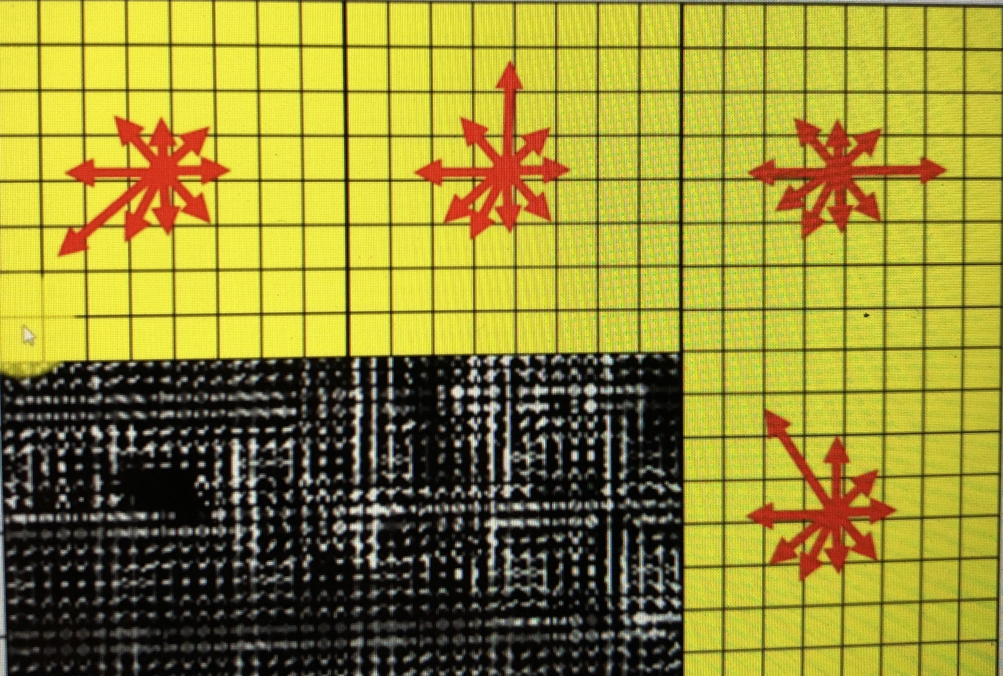
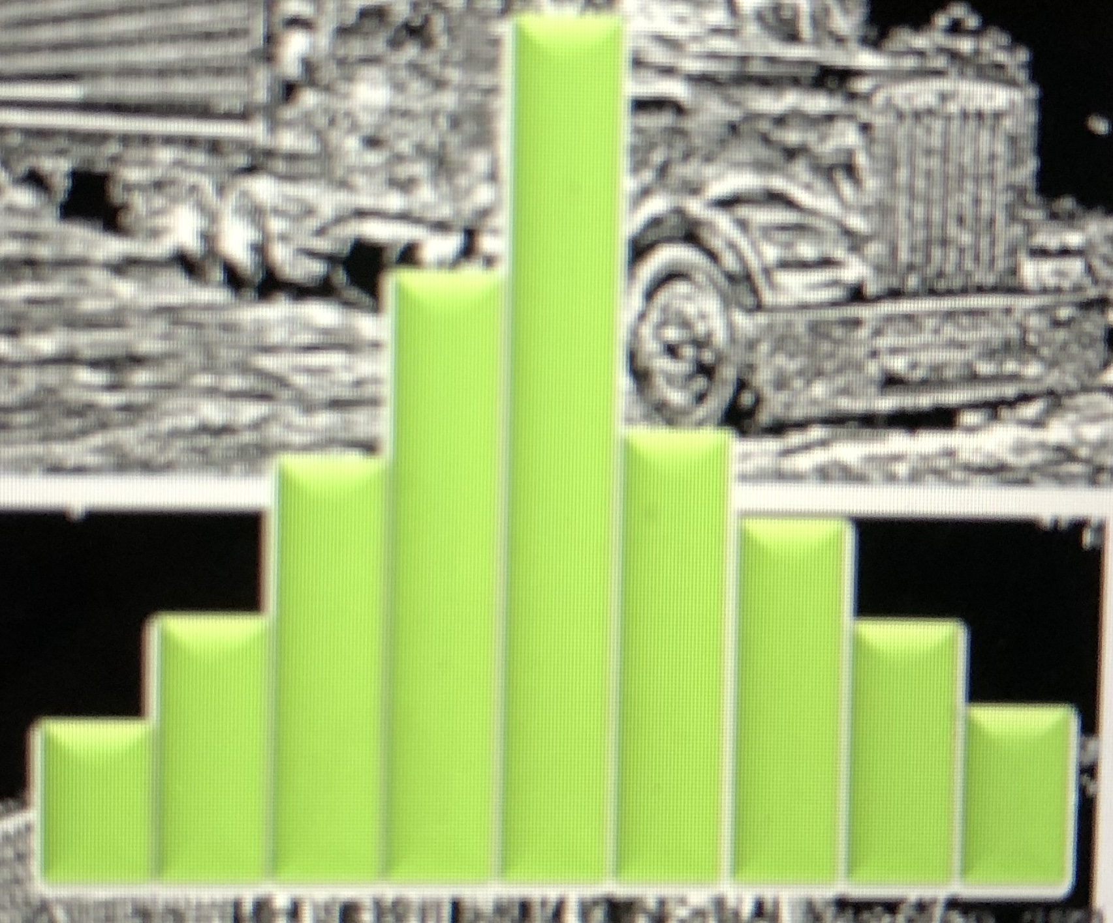
HISTOGRAM OF ORIENTED GRADIENTS
At each pixel, image gradient horizontal (x-direction) and vertical (y-direction) are calculated.
These vectors have a direction atan( 𝑦) and a magnitude ( (𝑓2 + 𝑓2)
The gradient value in the X-direction is 120-70=50 Y-direction is 100-50=50. Putting it together we will have [50 50] feature vector. The magnitude and direction aHOGs are a feature descriptor used for object detection.
Gradient Magnitude = 𝟓𝟎 𝟐 + 𝟓𝟎 𝟐 = 𝟕𝟎. 𝟏 Gradient Angle =𝐭𝐚𝐧−𝟏(𝟓𝟎/𝟓𝟎) = 𝟒𝟓°

Slide 28
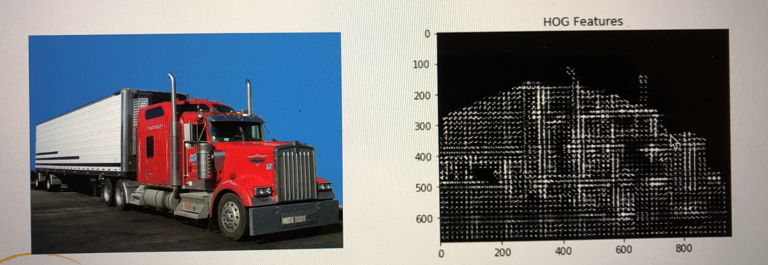
HOG Features
HOGs are a feature descriptor used for object detection.
HOGs along with SVM (support vector machine) classifiers work well for object detection.
HOG applies a sliding window detector over an image and HOG descriptor is computed for each position.
HOG takes care of the scaling issues by changing image scale (pyramiding).

Slide 29
Activity3:
Find a Truck Manually
Template Matching
Corner Detection
HISTOGRAM OF ORIENTED GRADIENTS
https://github.com/zyousefi105/portfolio/tree/master/autonomouscars/computer_vision3

Slide 30
What is machine learning?
machine learning systems train a model by feeding it feature data with known labels
features are the attributes used to inform your model’s predictions labels are the “correct answers” our model wants to be able to predict on its own
once the model is built, the model will predict labels just given feature data
features are independent variables, labels are dependent variables.
example: predicting sale price of a house --Regression
classifying images of street signs – Classification
Supervise vs Unsupervised

Slide 31
evaluating machine learning systems
if you have a set of training data that includes the value you’re trying to predict – you don’t have to guess if the resulting model is good or not.
if you have enough training data, you can split it into two parts: a training set and a test set.
you then train the model using only the training set
and then measure (using r-squared or some other metric) the model’s accuracy by asking it to predict values for the test set, and compare that to the known, true values.
the data sets must be selected randomly
train/test is a great way to guard against overfitting

Slide 32
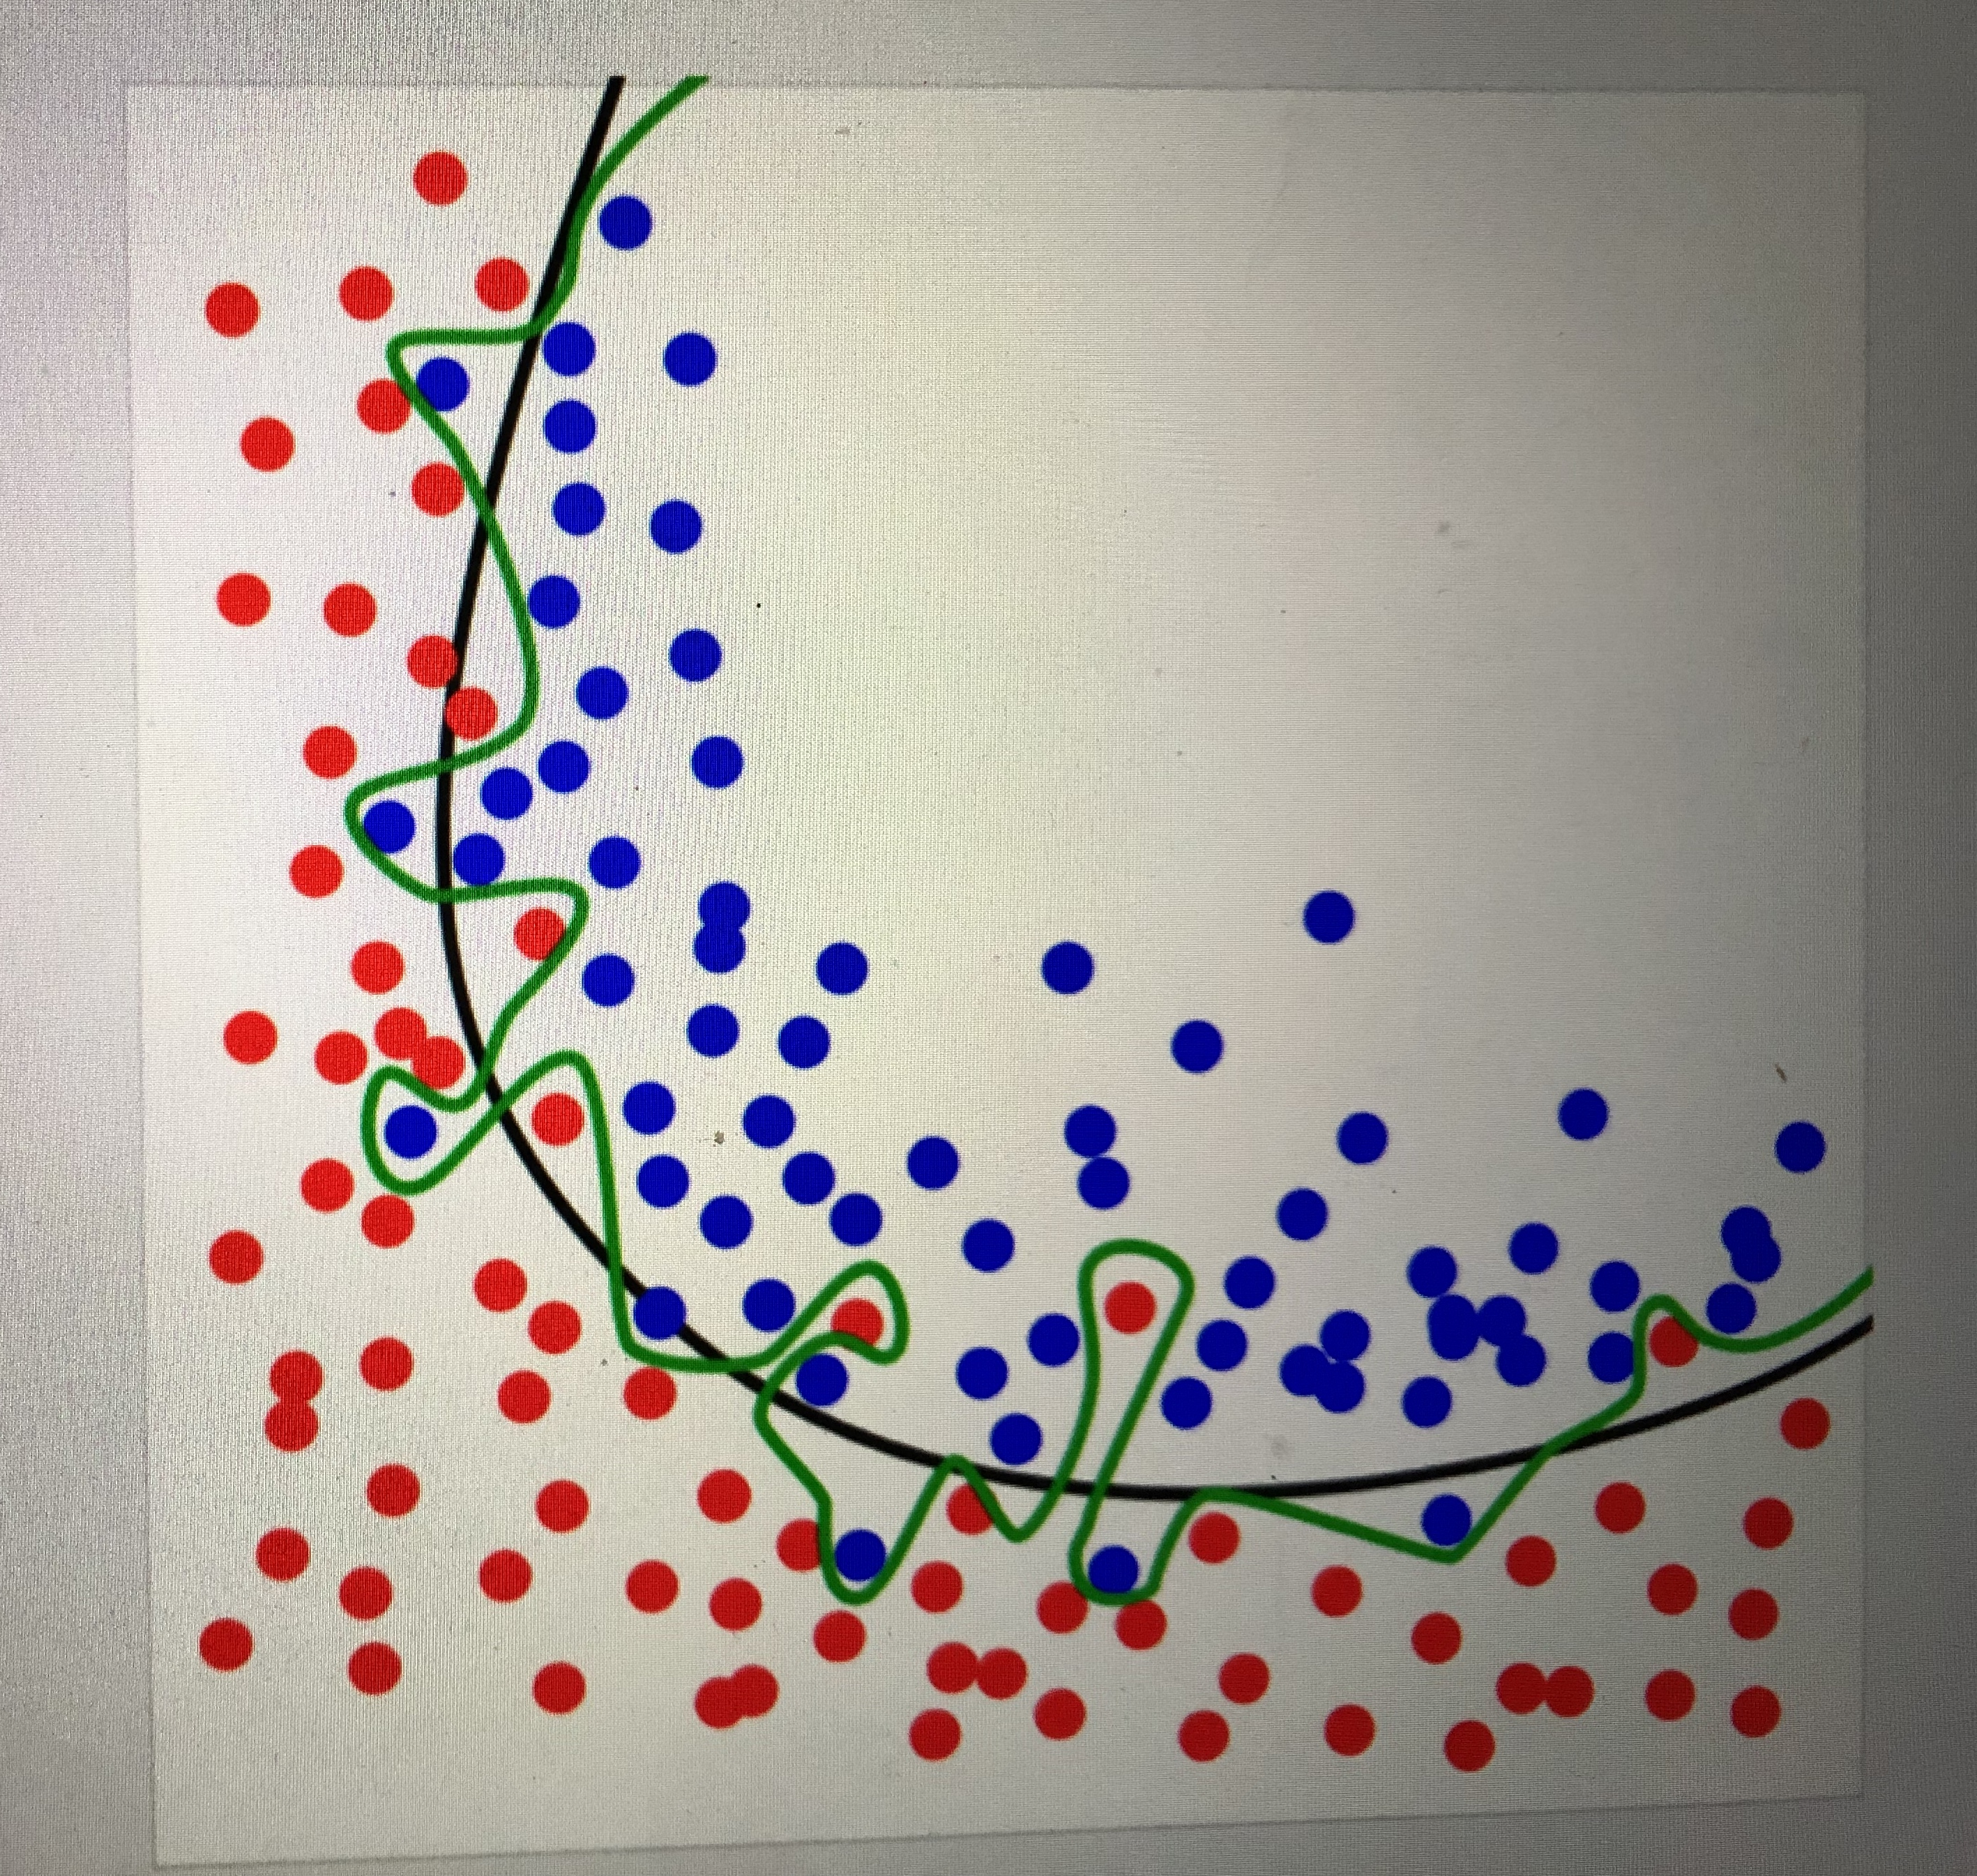
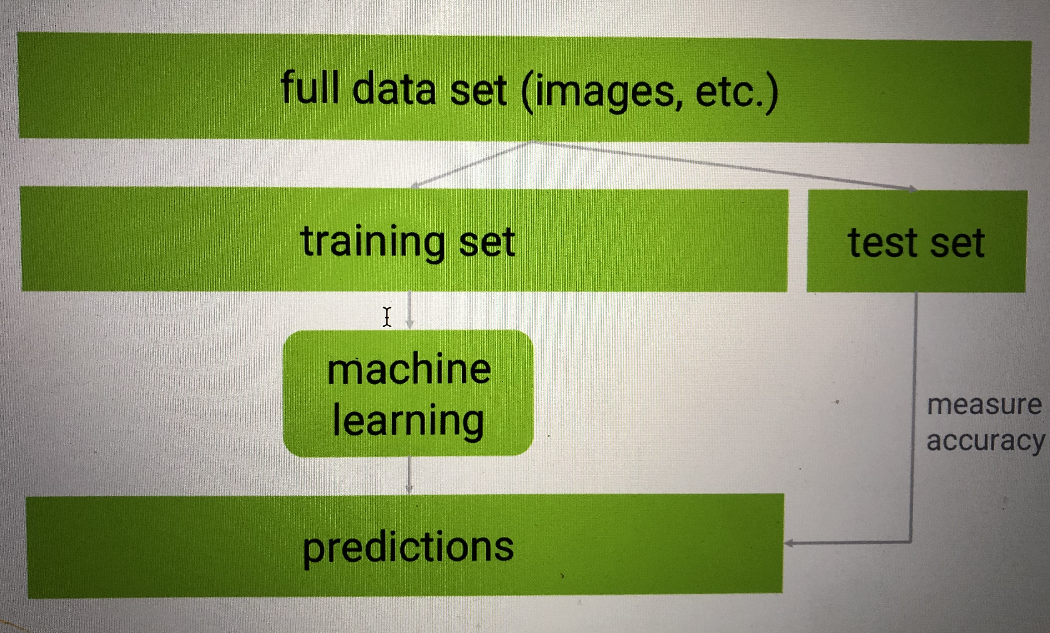
Overfitting

Slide 33
train/test is not infallible
maybe your sample sizes are too small or due to random chance your train and
test sets look remarkably similar • overfitting can still happen
k-fold cross validation
one way to further protect against overfitting is K-fold cross validation
• sounds complicated, but it’s a simple idea:
split your data into K randomly-assigned segments
reserve one segment as your test data
train on each of the remaining K-1 segments and measure their
performance against the test set
take the average of the K-1 r-squared scores

Slide 34
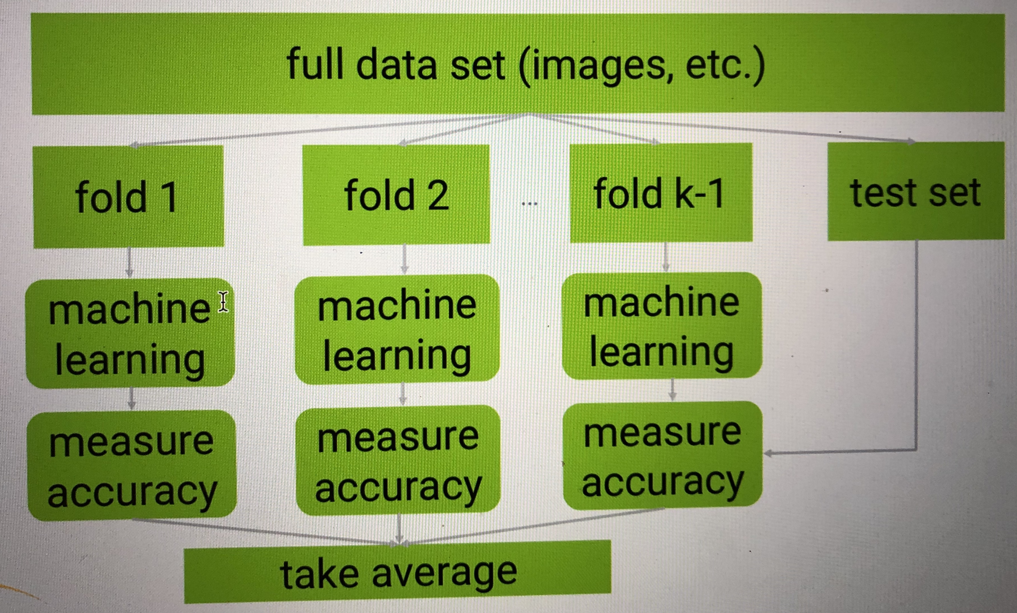
k-fold cross validation and Gridsearch

Slide 35
linear regression
• fit a line to a data set of observations
• use this line to predict unobserved values
• the term “regression” is confusing
remember the slope-intercept equation of a line? y=mx+b
the slope is the correlation between the two variables times the standard deviation in Y, all divided by the standard deviation in X.
• neat how standard deviation how some real mathematical meaning, eh?
the intercept is the mean of Y minus the slope times the mean of X
but python will do all that for you.

Slide 36
Measure Error
R-squared
The fraction of the total variation in Y that is captured by the model
ranges from 0 to 1 • 0 is bad (none of the variance is captured), 1 is good (all of the
variance is captured).
gradient descent
is an alternate method to ordinary least squares.
basically iterates to find the line that best follows the contours defined by the data.
can make sense when dealing with multi-dimensional data

Slide 37
logistic regression
regression for binary (yes/no) problems
like linear regression, but final predictions are transformed into a 0-1 range
the sigmoid (logistic) function
loss function for logistic regression
least-squares won’t work with the logistic curve
instead we use gradient descent with maximum likelihood
this just iterates to maximize the conditional probability of Y given X

Slide 38
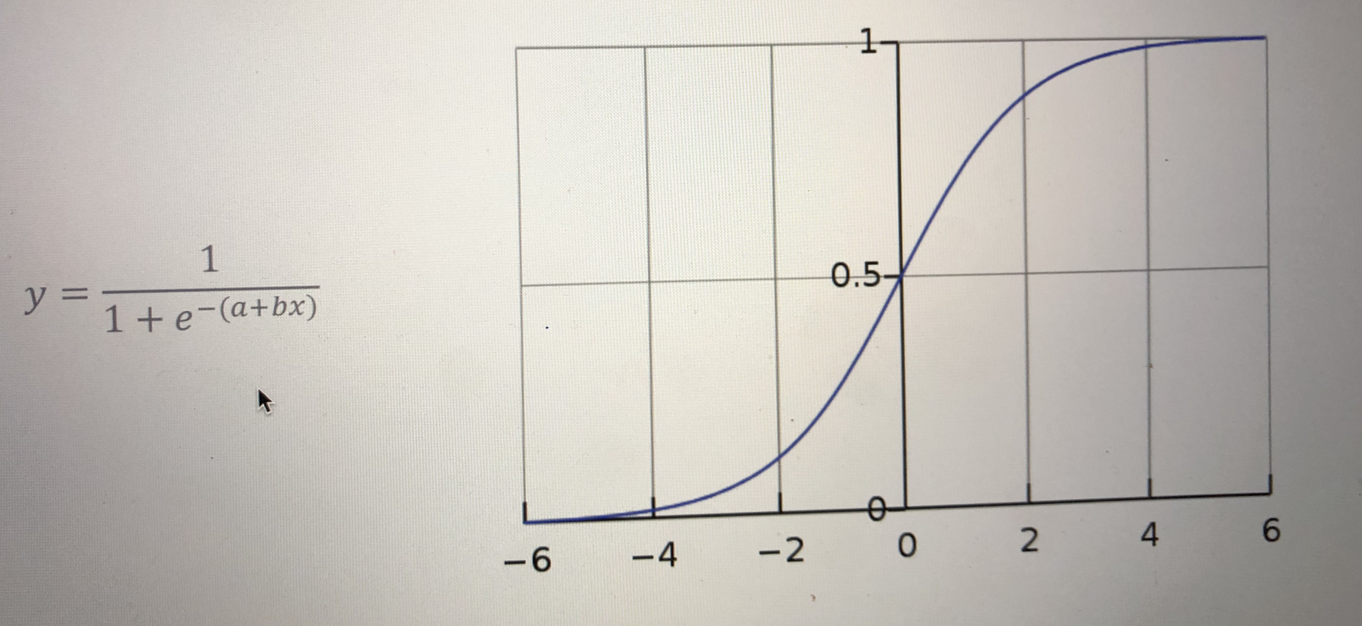

Slide 39
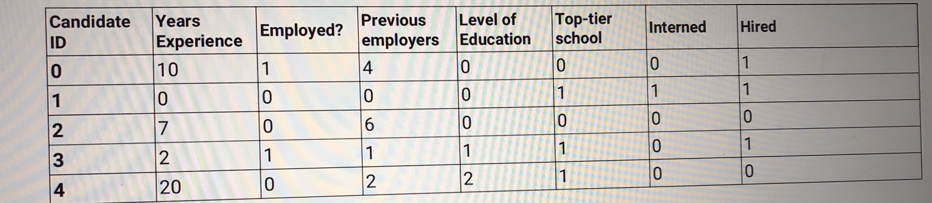
decision trees
you can actually construct a flowchart to help you decide a classification for something with machine learning
this is called a decision tree
• another form of supervised learning
hiring data

Slide 40
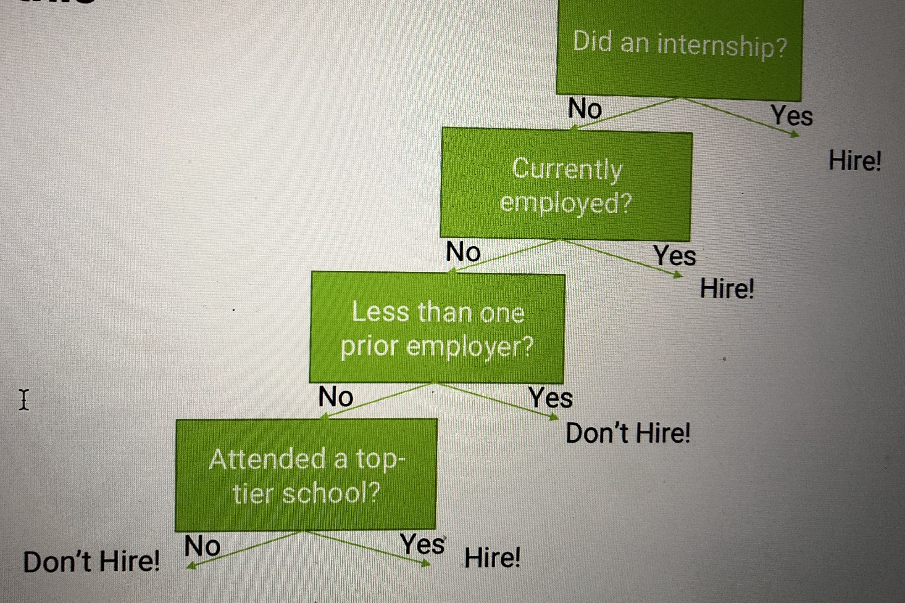

Slide 41
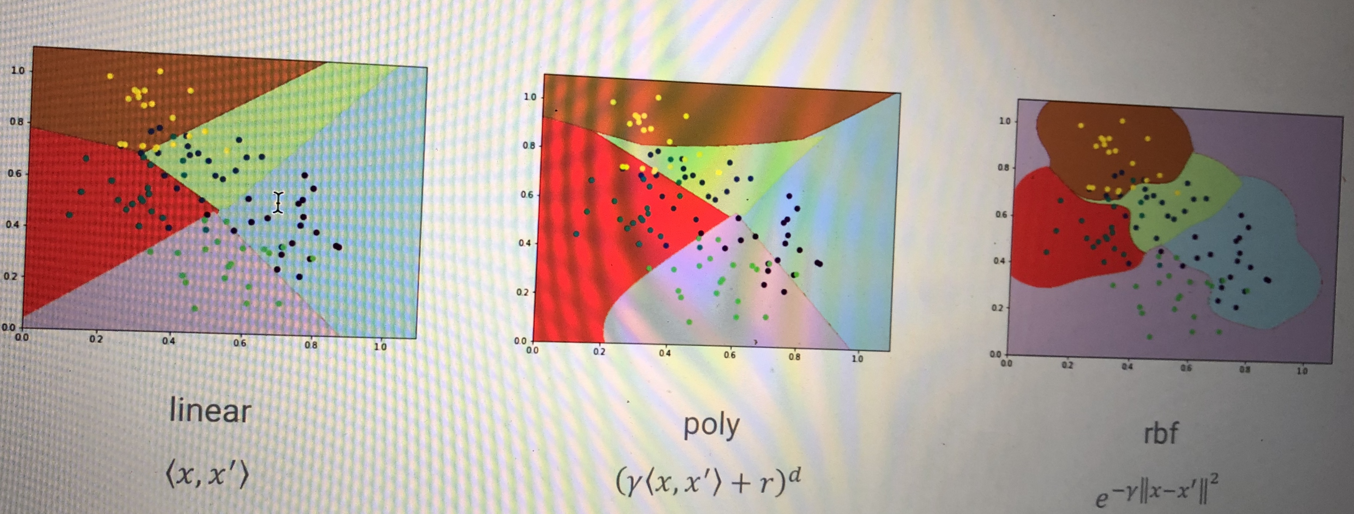
support vector machines
works well for classifying higher-dimensional data (lots of features)
these support vectors define hyperplanes
tuning kernels and gamma
use k-fold cross validation, GridSearchCV

Slide 42
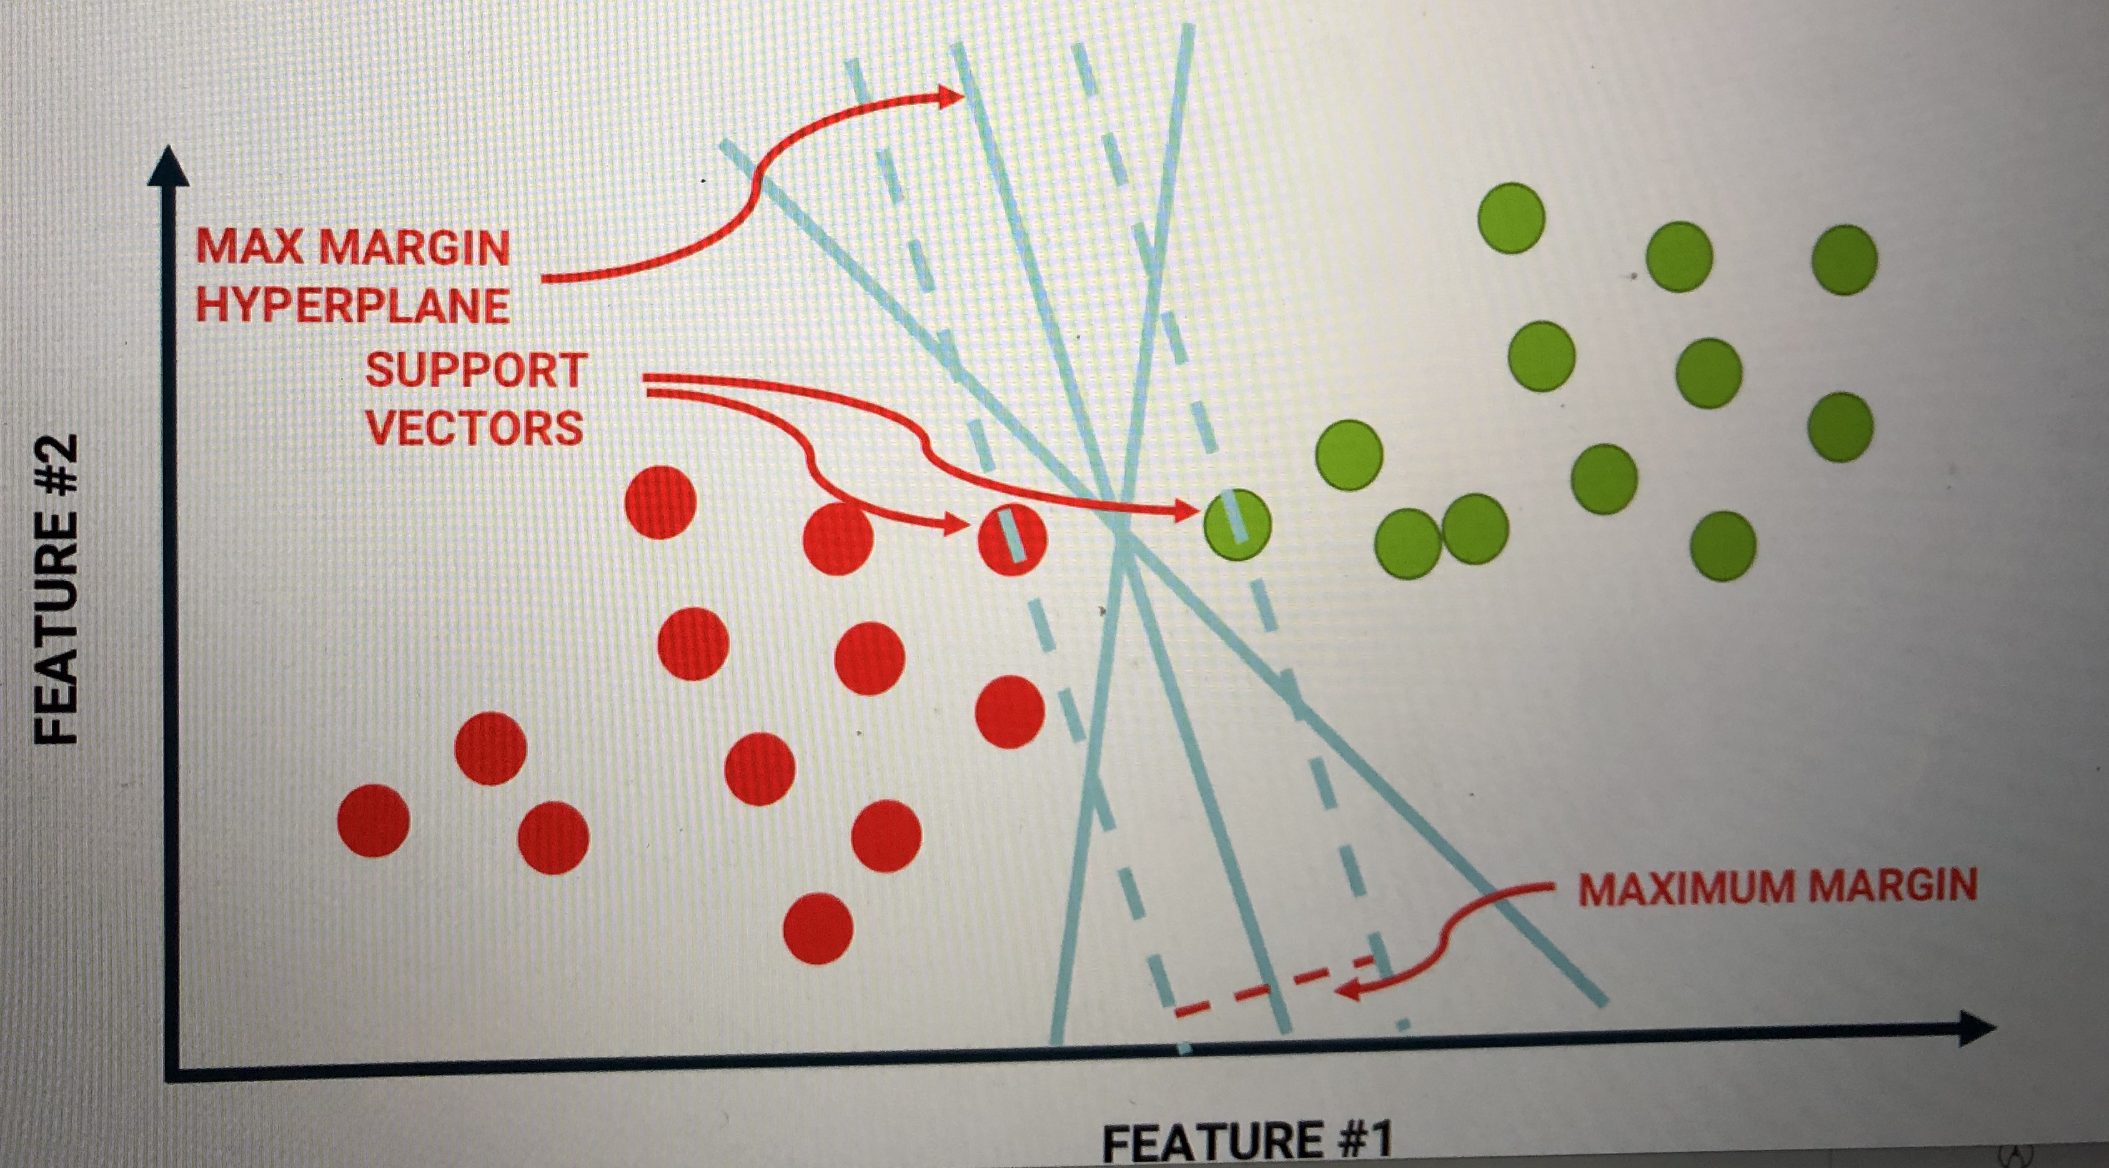

Slide 43
Activity 4:
Linear Regression
Logistic Regression
Decision Trees
SVM
http://localhost:8888/tree/autonomouscars/machine_learning1
http://localhost:8888/tree/autonomouscars/computer_vision3

Slide 44
ARTIFICIAL NEURAL NETWORK
ANNs are information processing models inspired by the human brain.
The brain has over 100 billion neurons communicating through electrical and chemical signals.
Neurons communicate with each other and help us see, think, and generate ideas.
Human brain learns by creating connections among these neurons.

Slide 45
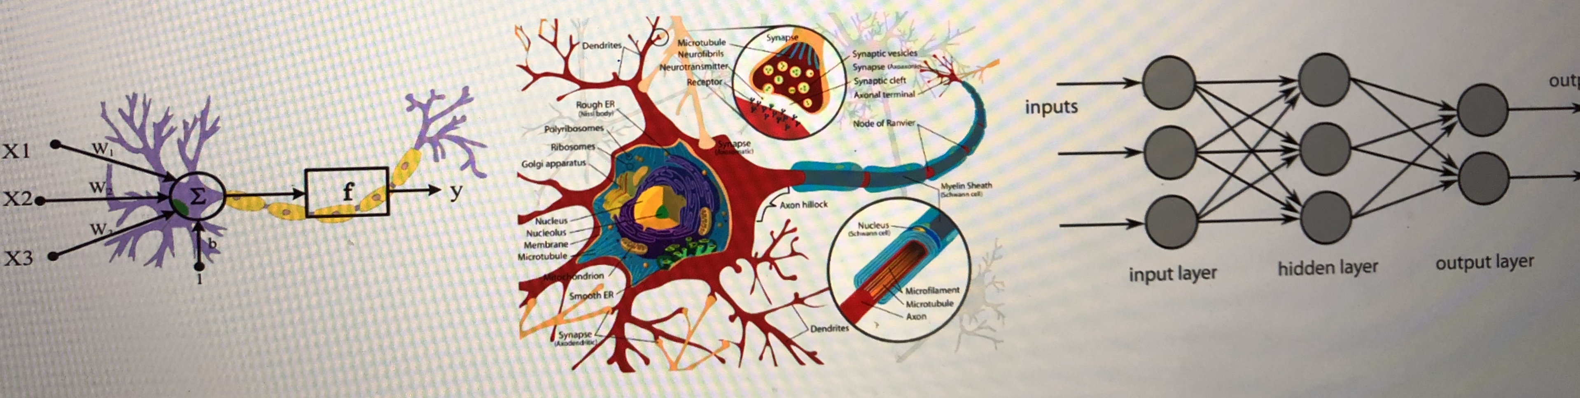

Slide 46
HOW DO HUMANS LEARN?
Humans learn from experience (by example).
ANNs will learn in the same fashion, by showing several training samples over and over again ‘epochs’.
ANNs are capable of modeling relationships between a set of inputs and outputs.
Brain has Excellent generalization capability.
A neural network with sufficient number of neurons can approximately model any continuous function with an acceptable degree of accuracy

Slide 47
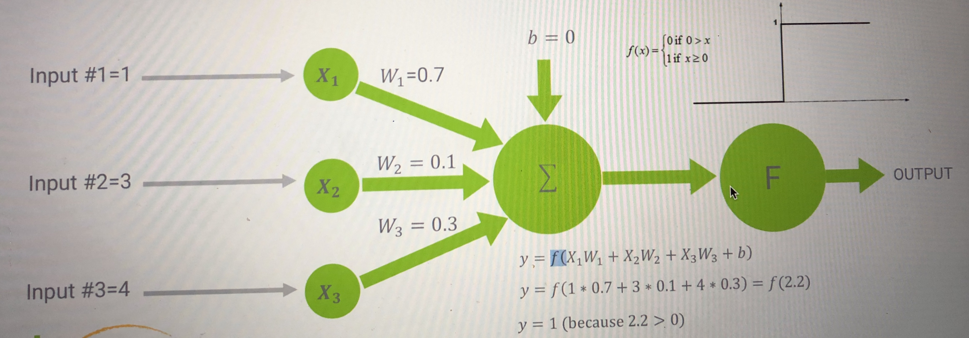
SINGLE NEURON MODEL

Slide 48
ANNs APPLICATIONS
Self-driving cars
Imageclassification
Fault detection and isolation
Face and speech recognition
Systemidentificationandcontrolsystemsapplications
Fingerprintsrecognition
Handwrittencharacterrecognition
Business applications such as bank failure prognosis and stock market predictions

Slide 49
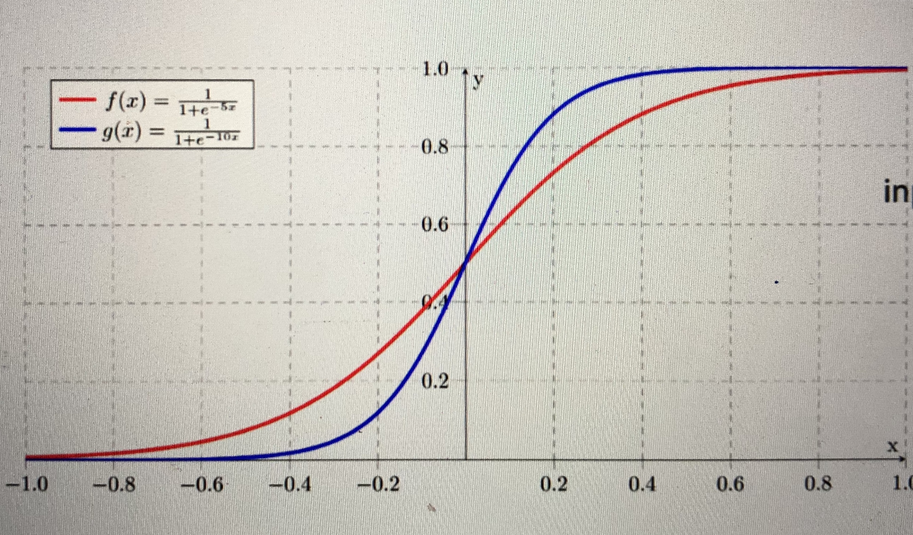
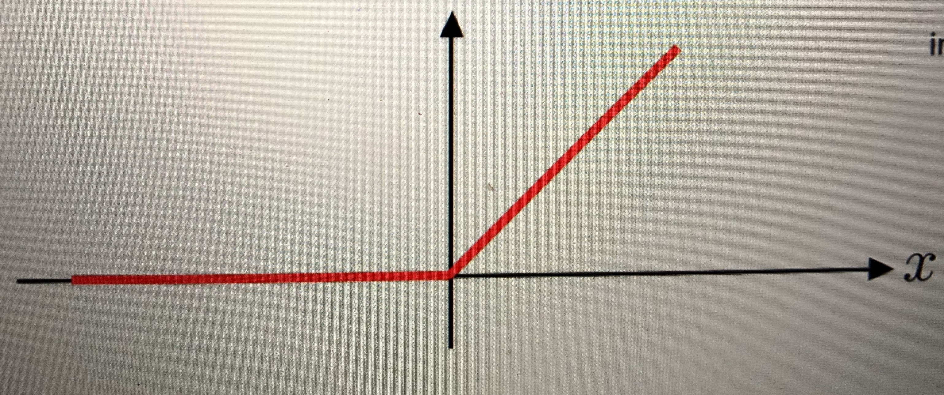
ACTIVATION FUNCTIONS
SIGMOID:
Takes a number and sets it between 0 and 1
Converts large negative numbers to 0 and large positive numbers to 1.
Generally used in output layer.
RELU (RECTIFIED LINEAR UNITS):
if input x < 0, output is 0 and if x > 0 the output is x.
Generally used in hidden layers
softmax function is used for the multiclass logistic regression

Slide 50
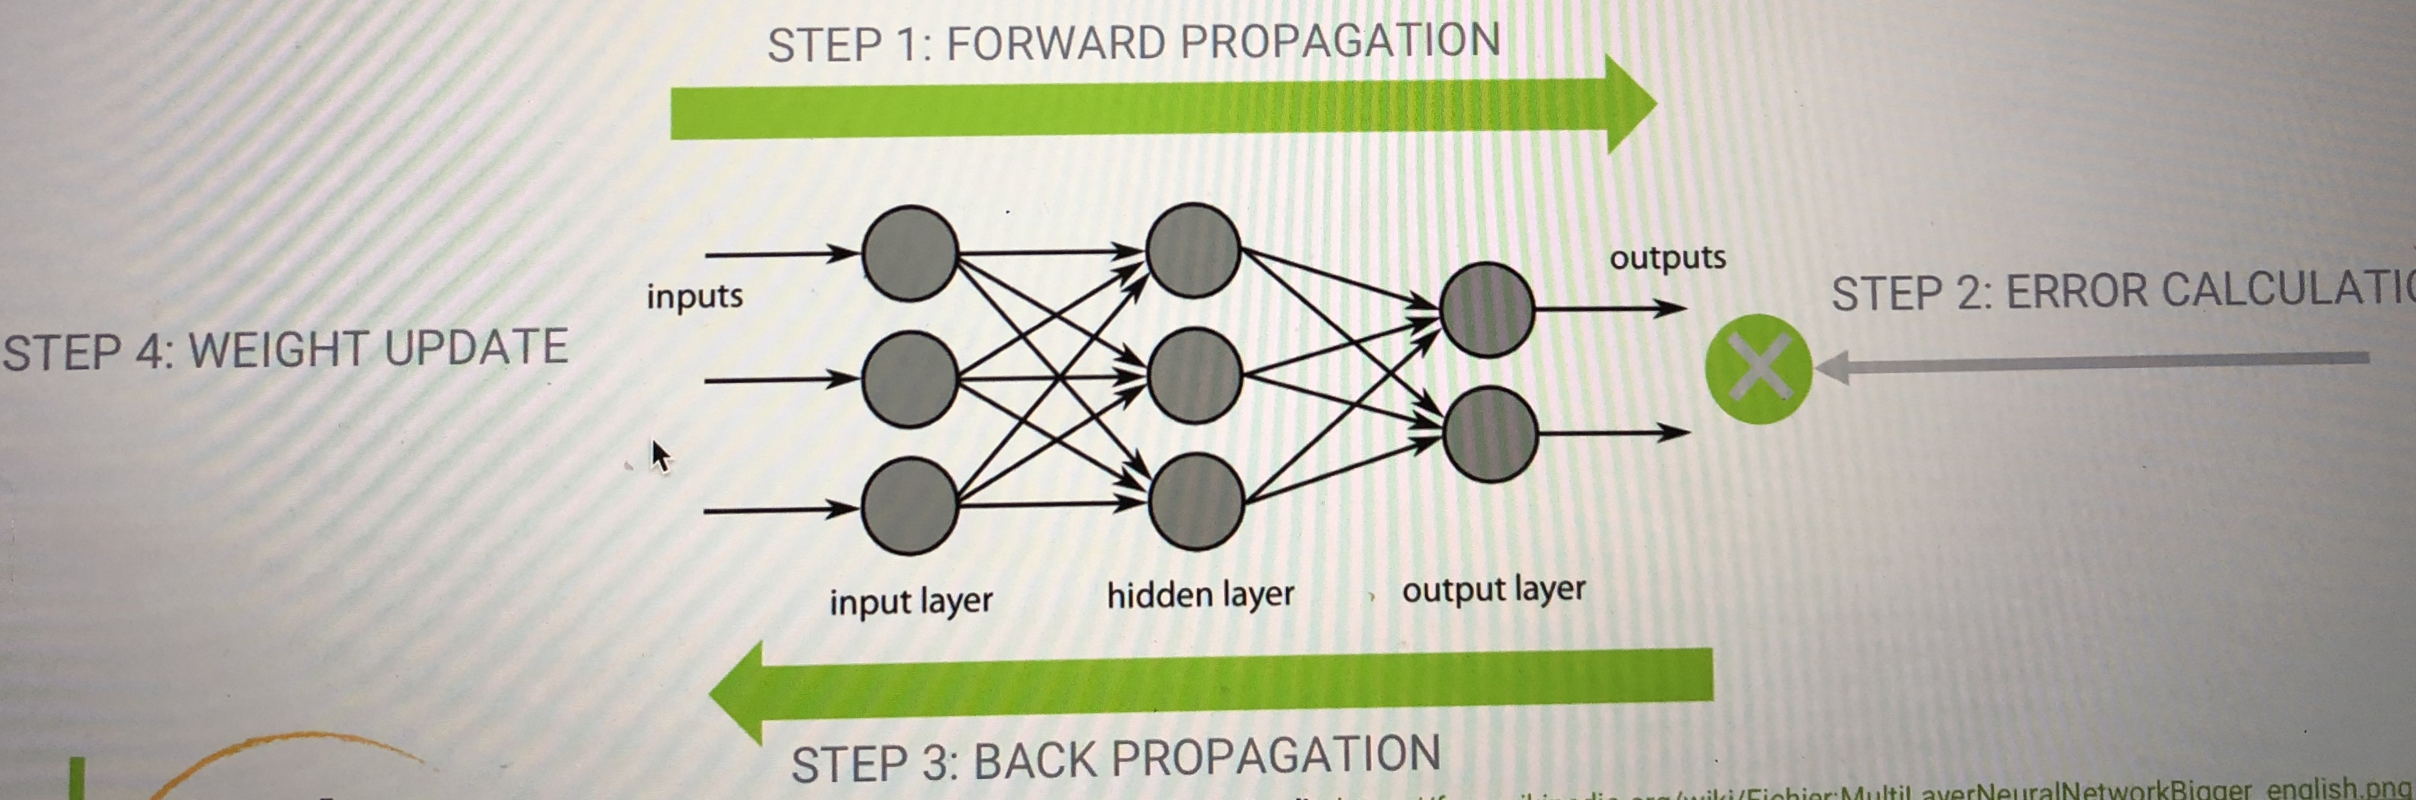
BACK PROPAGATION
Backpropagation is a method used to train ANNs by calculating gradient needed to update network weights. It is commonly used by the gradient descent optimization algorithm to adjust the weight of neurons by calculating the gradient of the loss function.

Slide 51
MULTILAYER PERCEPTRON ANN MODEL
SIMULATION:
https://playground.tensorflow.org

Slide 52
Tensorflow
it’s not specifically for neural networks– it’s more generally an
architecture for executing a graph of numerical operations
tensorflow can optimize the processing of that graph, and distribute its processing across a network
import tensorflow as tf
a = tf.Variable(1, name="a") b = tf.Variable(2, name="b") f =a+b
init = tf.global_variables_initializer() with tf.Session() as s:
init.run() print( f.eval() )

Slide 53
keras to the rescue
easy and fast prototyping
higher-level API for Tensorflow
made for building deep neural nets
scikit_learn integration
less to think about – which often yields better results without even trying

Slide 54
Example: multi-class classification
model = Sequential()
model.add(Dense(64, activation='relu', input_dim=20))
model.add(Dense(64, activation='relu’))
model.add(Dense(10, activation='softmax’))
sgd = SGD(lr=0.01, decay=1e-6, momentum=0.9, nesterov=True)
model.compile(loss='categorical_crossentropy’, optimizer=sgd, metrics=['accuracy'])

Slide 55
example: binary classification
model = Sequential() model.add(Dense(64, input_dim=20, activation='relu’))
model.add(Dense(64, activation='relu’))
model.add(Dense(1, activation='sigmoid’))
model.compile(loss='binary_crossentropy', optimizer='rmsprop’, metrics=['accuracy'])

Slide 56
make sure your features are normalized
• neural networks usually work best if your input data is normalized.
• That is, 0 mean and unit variance
• The real goal is that every input feature is comparable in terms of magnitude
• scikit_learn’s StandardScaler can do this for you • many data sets are normalized to begin with

Slide 57
Avoiding overfitting with regularization
With thousands of weights to tune, overfitting is a problem
Early stopping (when performance starts dropping)
Regularization terms added to cost function during training
Dropout – ignore say 50% of all neurons randomly at each training step
• Works surprisingly well! • Forces your model to spread out its learning

Slide 58
Convolutional Neural Networks
when you have data that doesn’t neatly align into columns
• Images that you want to find features within • Machine translation • Sentence classification • Sentiment analysis
they can find features that aren’t in a specific spot
• Like a stop sign in a picture • Or words within a sentence
• they are “feature-location invariant”

Slide 59
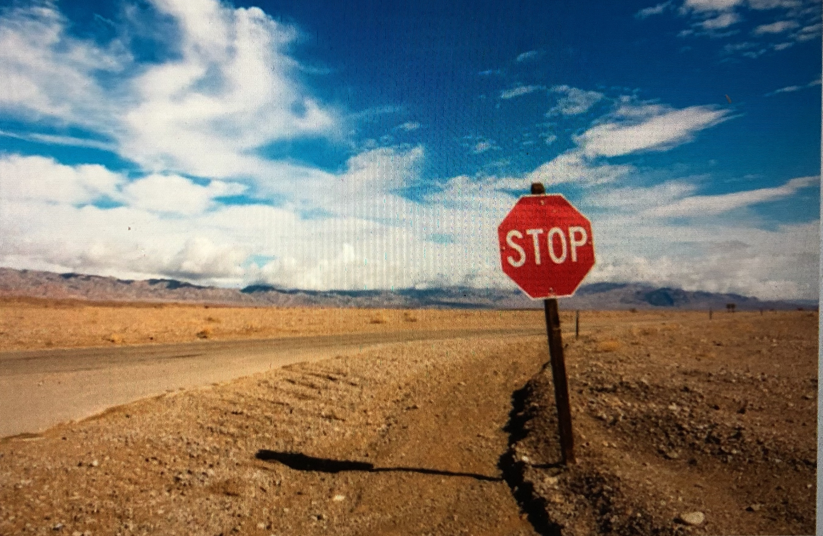
how do we “know” that’s a stop sign?

Slide 60
how do we “know” that’s a stop sign?
individual local receptive fields scan the image looking for edges, and pick up the edges of the stop sign in a layer
those edges in turn get picked up by a higher level convolution that identifies the stop sign’s shape (and letters, too)
this shape then gets matched against your pattern of what a stop sign looks like, also using the strong red signal coming from your red layers
that information keeps getting processed upward until your foot hits the brake!
a CNN works the same way

Slide 61
How do they work?
inspired by the biology of the visual cortex local receptive fields are groups of neurons that only respond to a part of
what your eyes see (subsampling)
they overlap each other to cover the entire visual field (convolutions)
they feed into higher layers that identify increasingly complex images
some receptive fields identify horizontal lines, lines at different angles, etc. (filters)
these would feed into a layer that identifies shapes
which might feed into a layer that identifies objects
for color images, extra layers for red, green, and blue

Slide 62
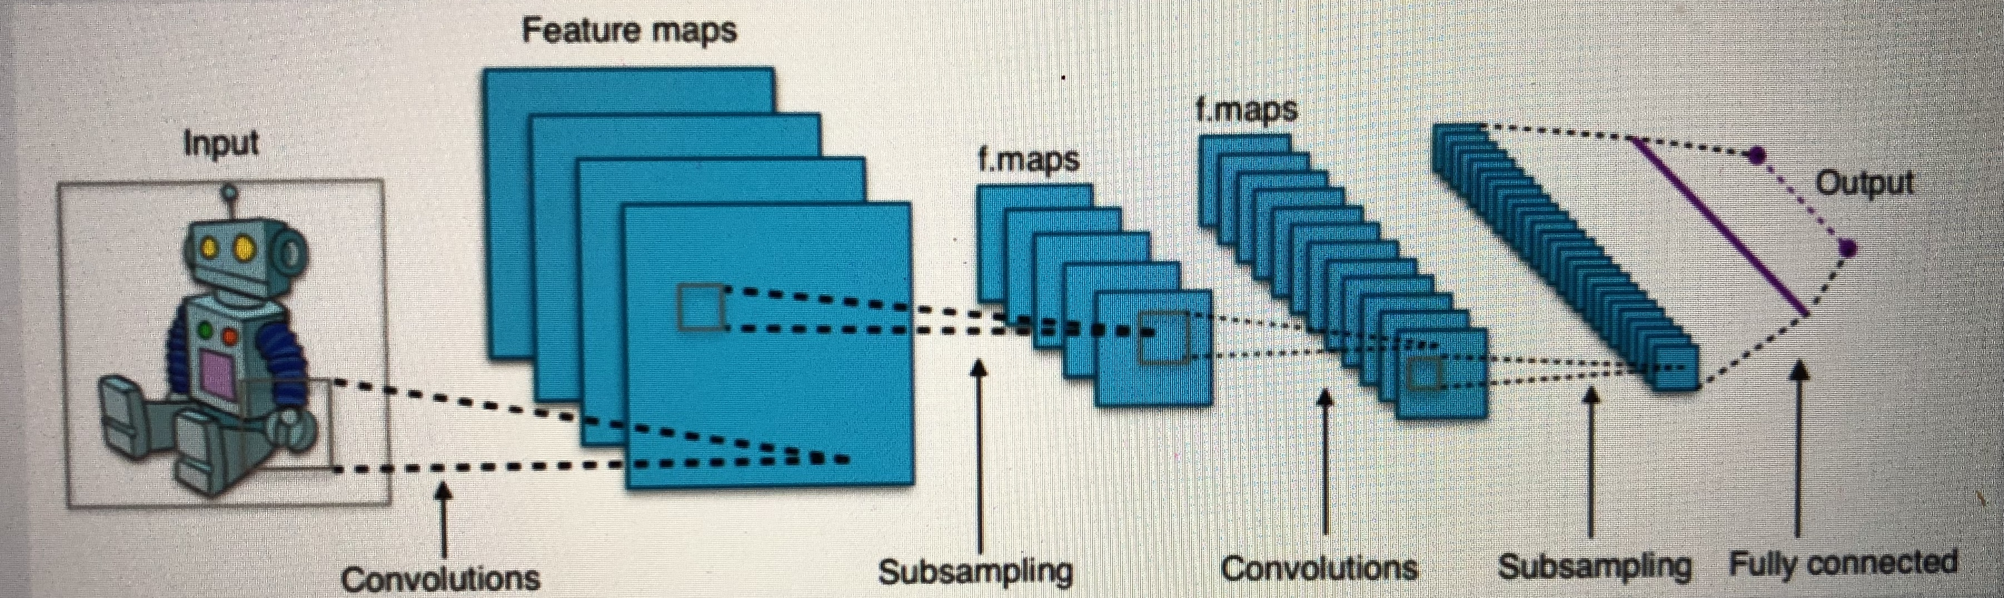
inspired by the biology of the visual cortex

Slide 63
CNN with keras
source data must be of appropriate dimensions • ie width x length x color channels
conv2D layer type does the actual convolution on a 2D image • Conv1D and Conv3D also available – doesn’t have to be image data
flatten layers will convert the 2D layer to a 1D layer for passing into a flat hidden layer of neurons
typical usage: • Convolve -> Dropout -> Flatten -> Dense -> Dropout -> Softmax

Slide 64
CNNs are hard
very resource-intensive (CPU, GPU, and RAM)
lots of hyperparameters
kernel sizes, many layers with different numbers of units, amount of pooling... in addition to the usual stuff like number of layers, choice of optimizer
getting the training data is often the hardest part! (As well as storing and accessing it)

Slide 65
specialized cnn architectures
defines specific arrangement of layers, padding, and hyperparameters
LeNet-5
good for handwriting recognition
AlexNet
image classification, deeper than LeNet
GoogLeNet
even deeper, but with better performance introduces inception modules (groups of convolution layers)
ResNet (Residual Network) even deeper – maintains performance via skip connections.

Slide 66
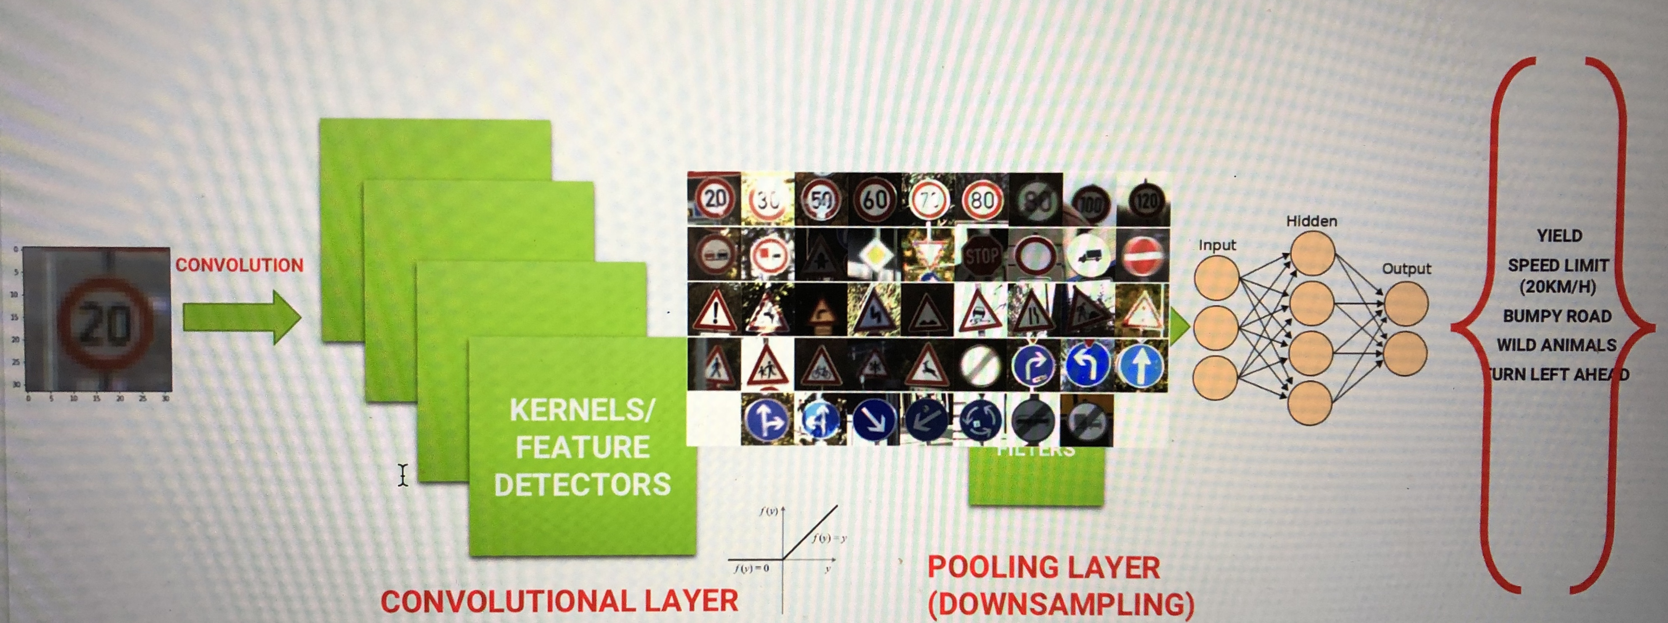
CONVOLUTIONAL NEURAL NETWORK OVERVIEW

Slide 67
MAXPOOLING/FLATTENING
Pooling or down sampling layers are placed after convolutional layers to reduce feature map dimensionality.
This improves the computational efficiency while preserving the features.
Pooling helps the model to generalize by avoiding overfitting. If one of the pixel is shifted, the pooled feature map will still be the same.
Max pooling works by retaining the maximum feature response within a given sample size in a feature map.
Live illustration : http://scs.ryerson.ca/~aharley/vis/conv/flat.html

Slide 68
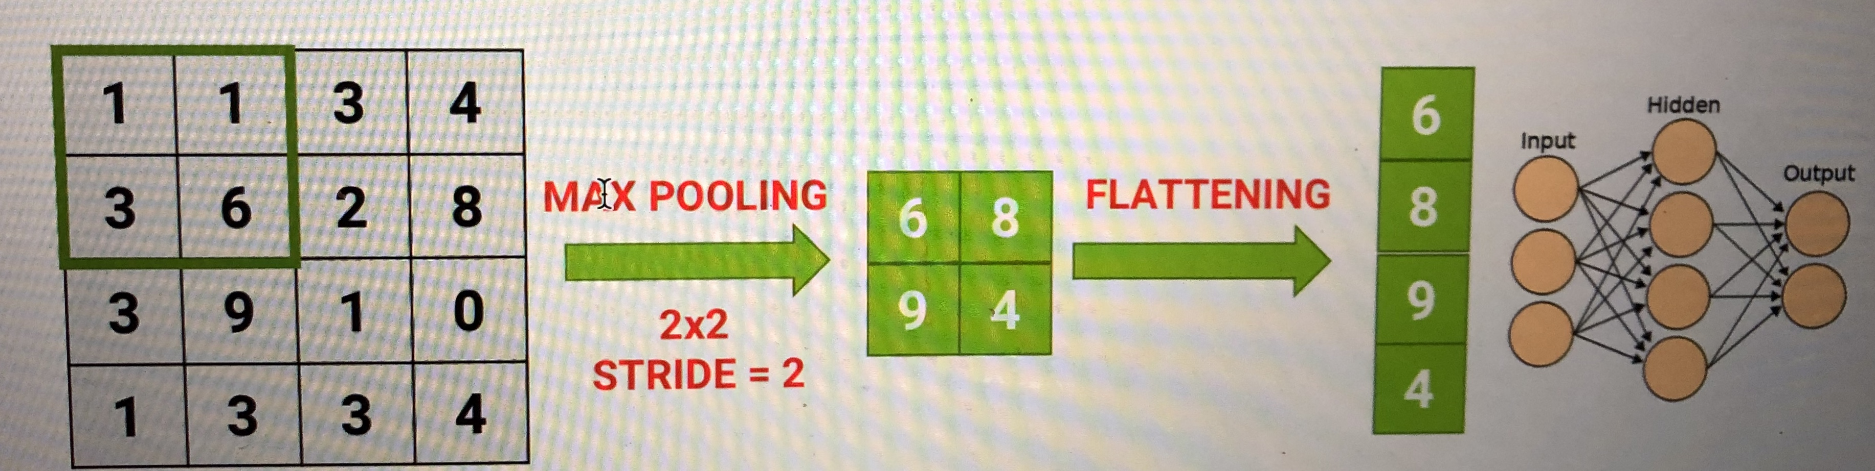
MAXPOOLING/FLATTENING

Slide 69
Activity 5:
Train a deep network to classify traffic signs
https://github.com/zyousefi105/portfolio/tree/master/autonomouscars/deep_learning_tensorflow2

Slide 70


